Slide 1
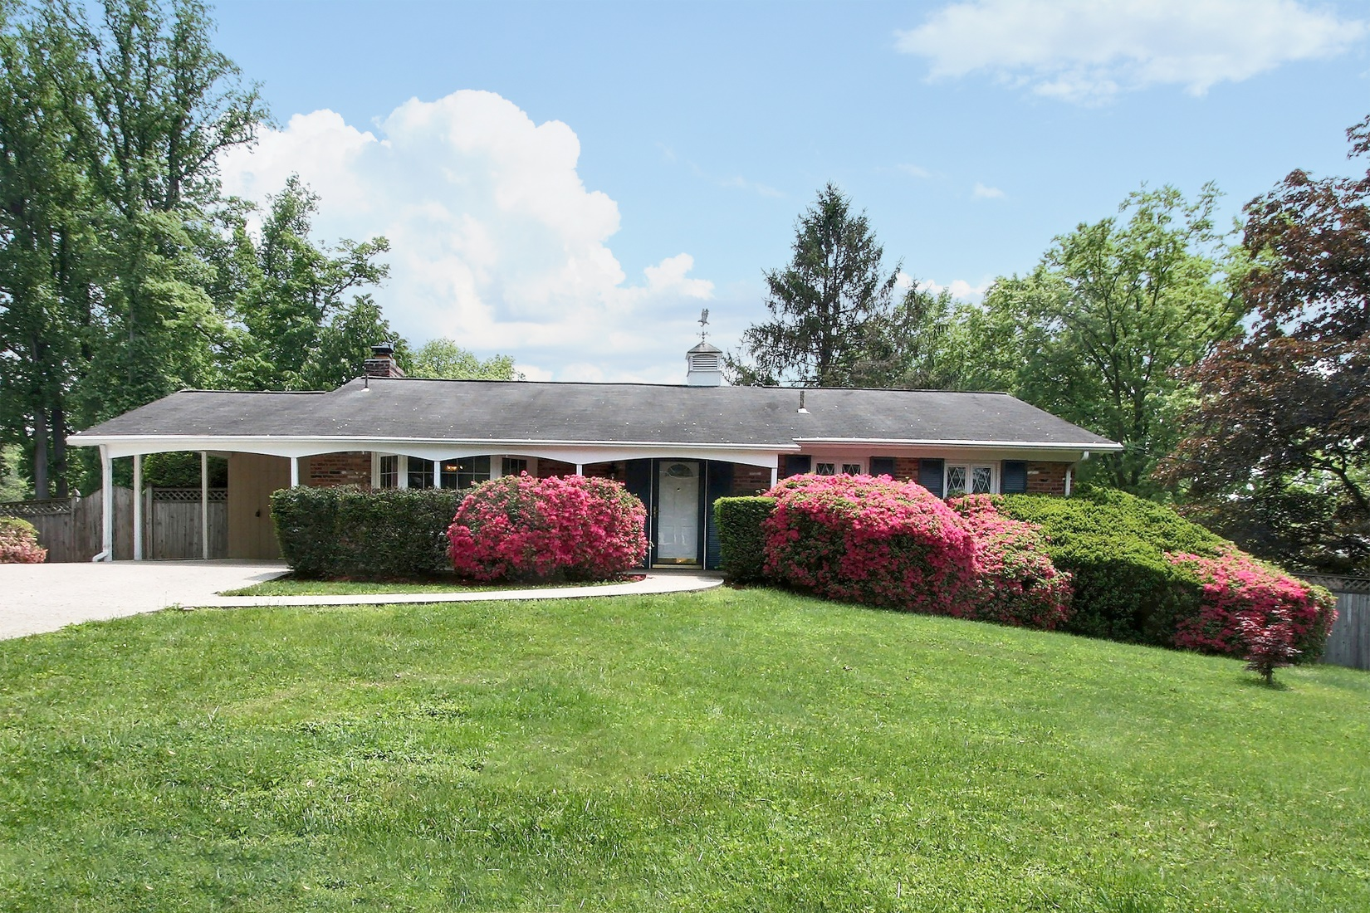
13111 Hathaway Dr, Silver Spring, MD 20906
4
BEDROOMS
3
BATHROOMS
$3,988
ANNUAL
TAXES
~2,700
SQUARE
FEET
.289
ACRES
1962
YEAR BUILT
Property Highlights:
Freshly refinished hardwood throughout main level
Updated kitchen with high-end appliances
Walk-out lower level leading to rear deck
An abundance of storage with multiple sheds, including a 2-level Amish shed wired for electricity
Freshly renovated master bath
A whole house backup generator
Virtual Tour Online: 13111.AlexSaenger.com
301-251-1221 x1000
Homes@AlexSaenger.com

Slide 2
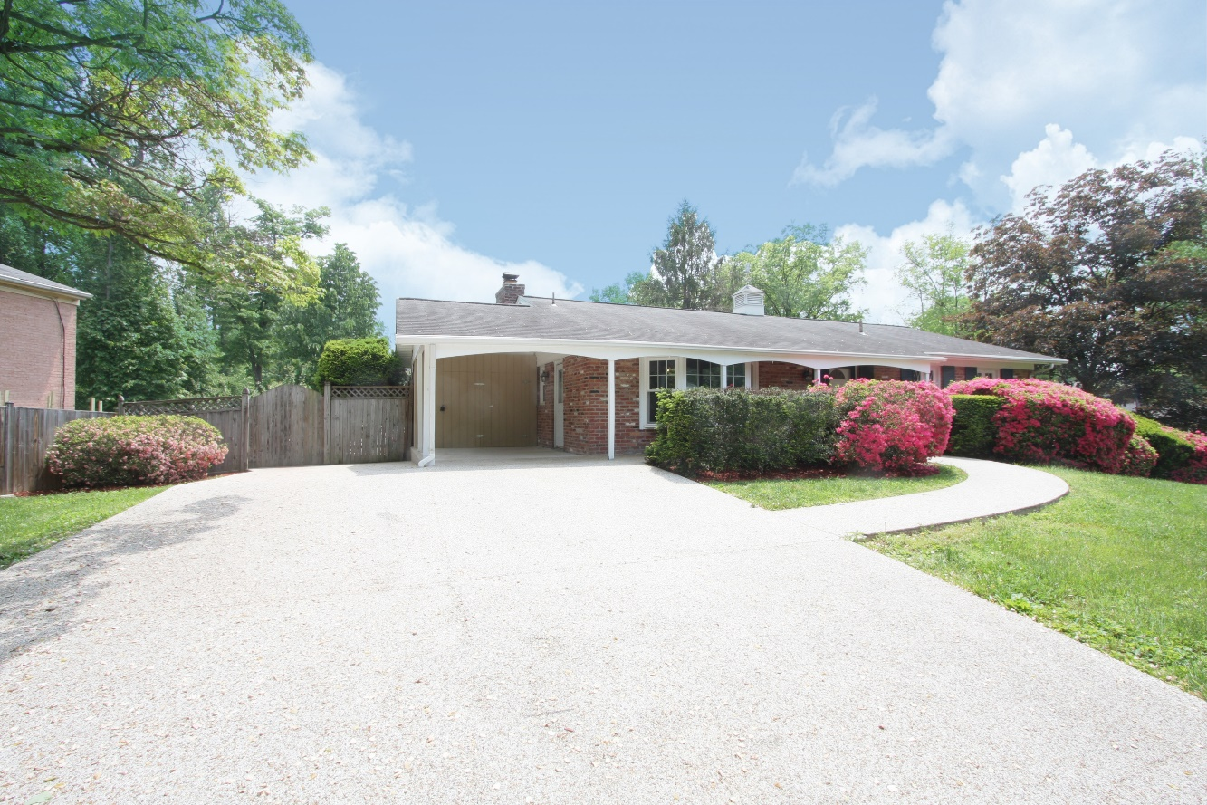
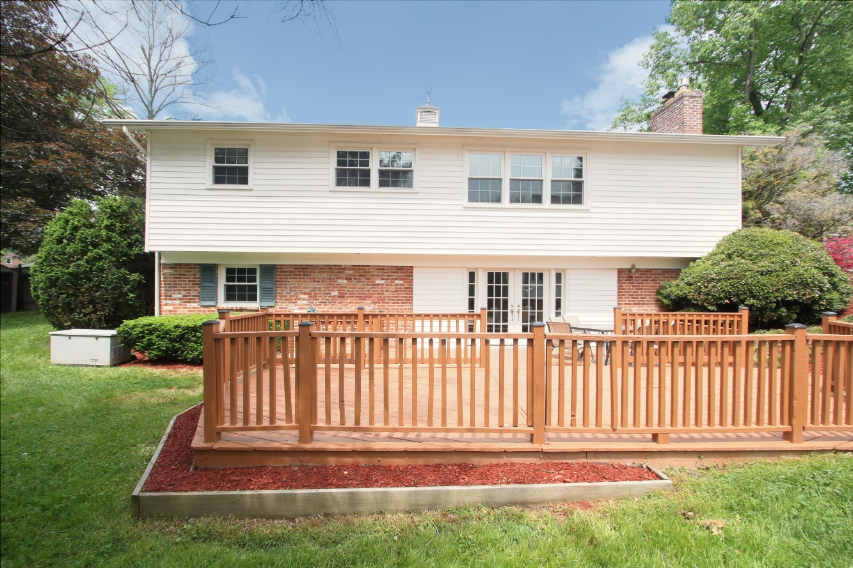
Large 5-Car Driveway and walk covered with high-end Durastone™. 1-Car Carport with all permits for an extension. Front door and French doors on lower-level equipped with highest residential security.

Slide 3
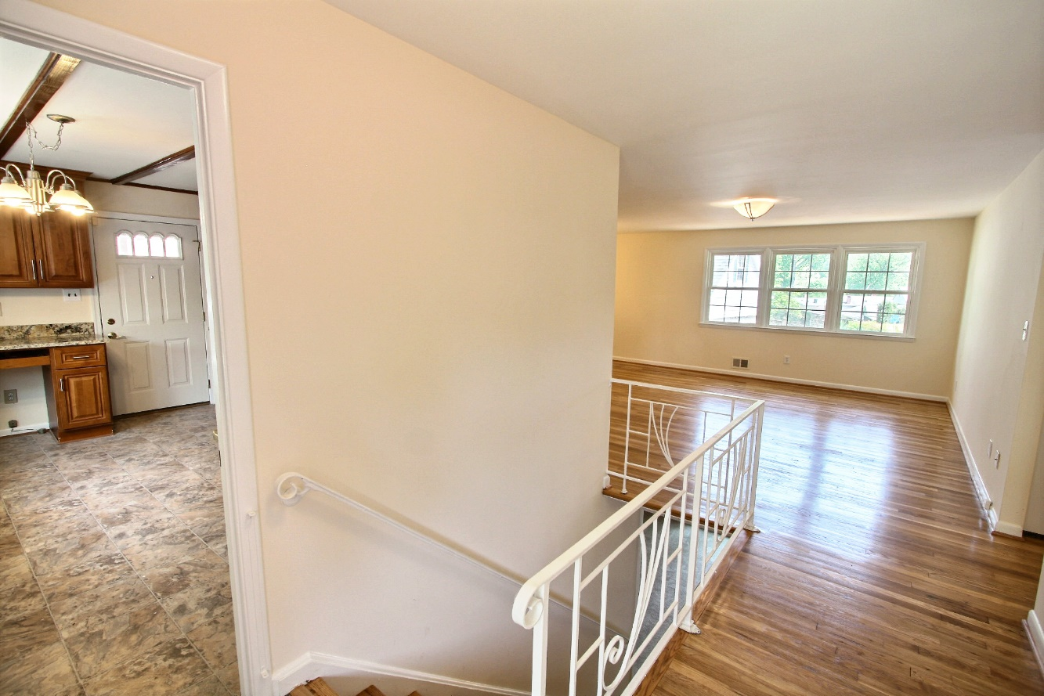
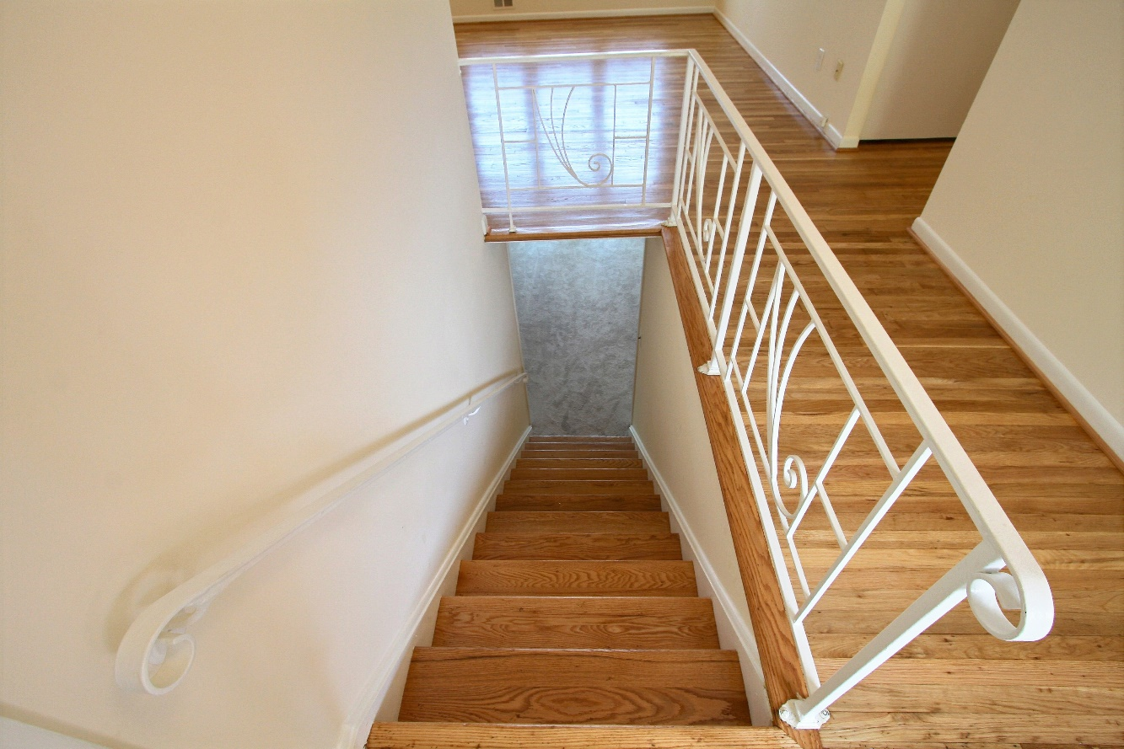
The upstairs features freshly refinished hardwood floors, fresh paint, and updated windows. The whole house is equipped with an ADT security system with sensors.

Slide 4
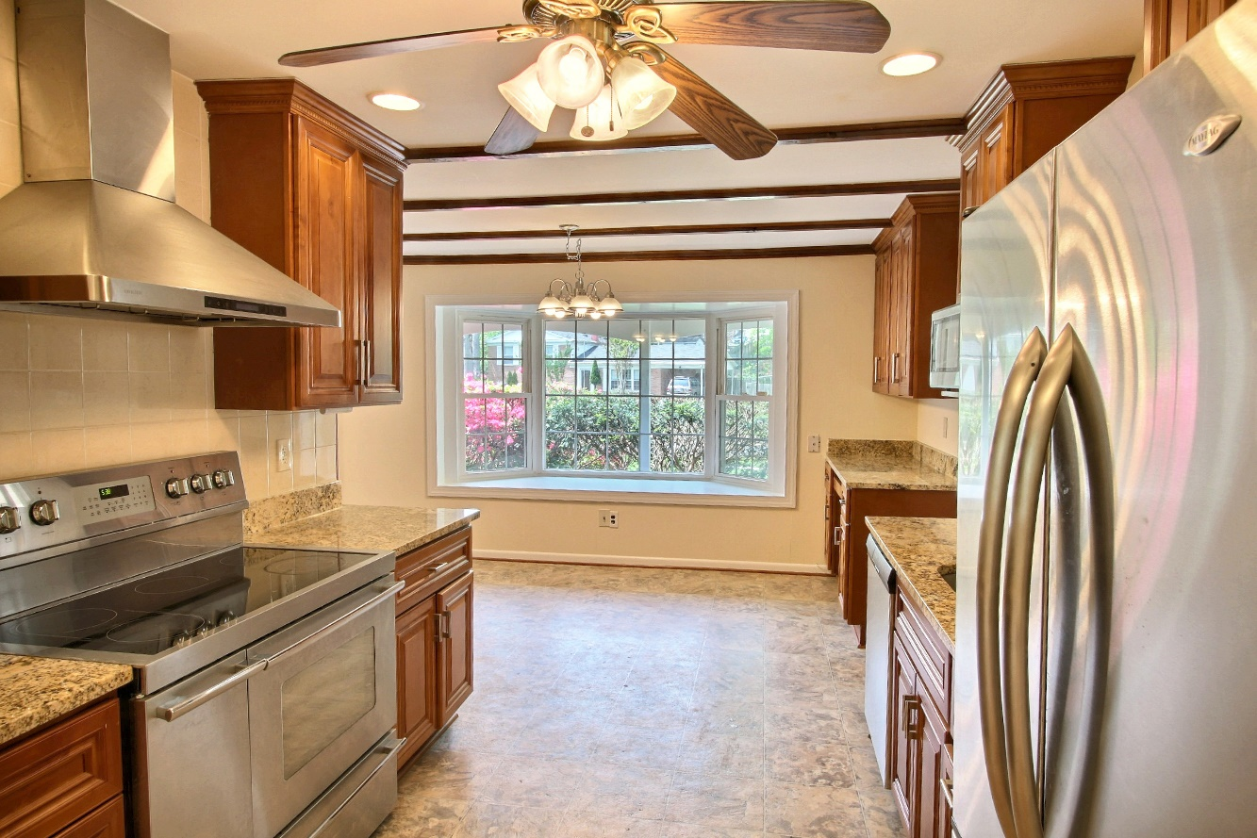
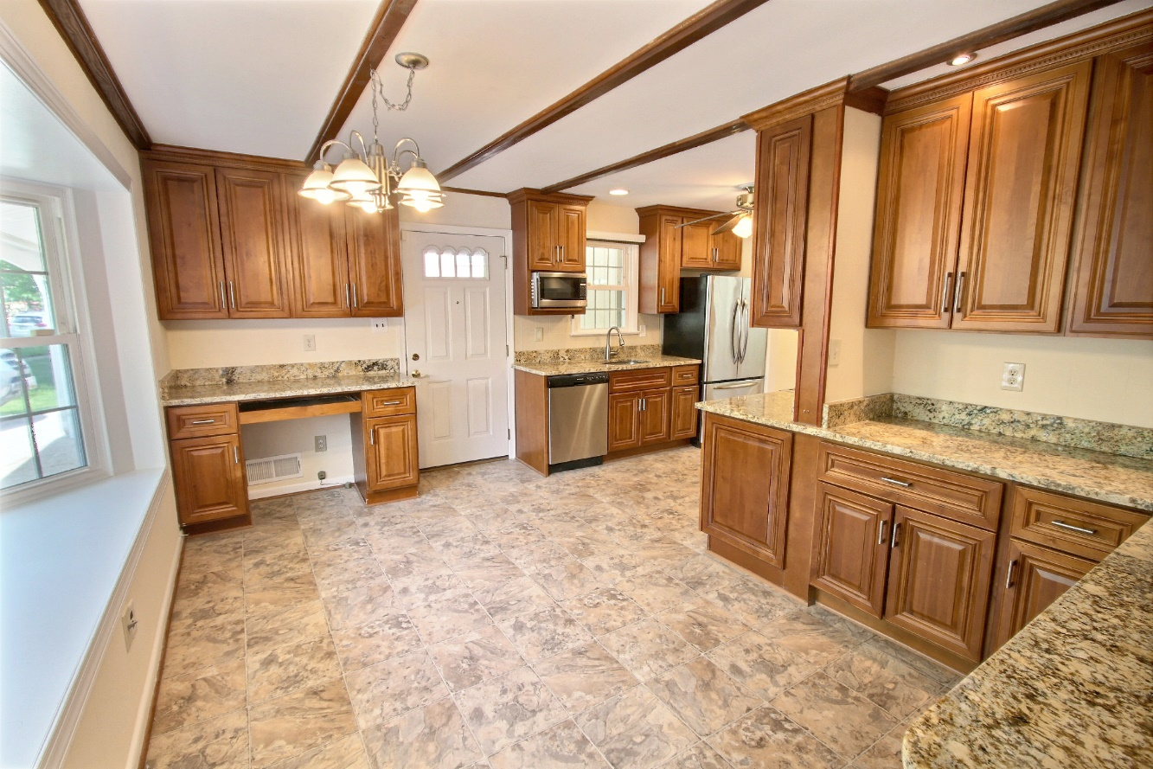
The remodeled kitchen includes new high-end steel appliances (refrigerator, oven, hood, microwave, and dishwasher). There are new light fixtures, granite counters and an extra-wide bay window.

Slide 5
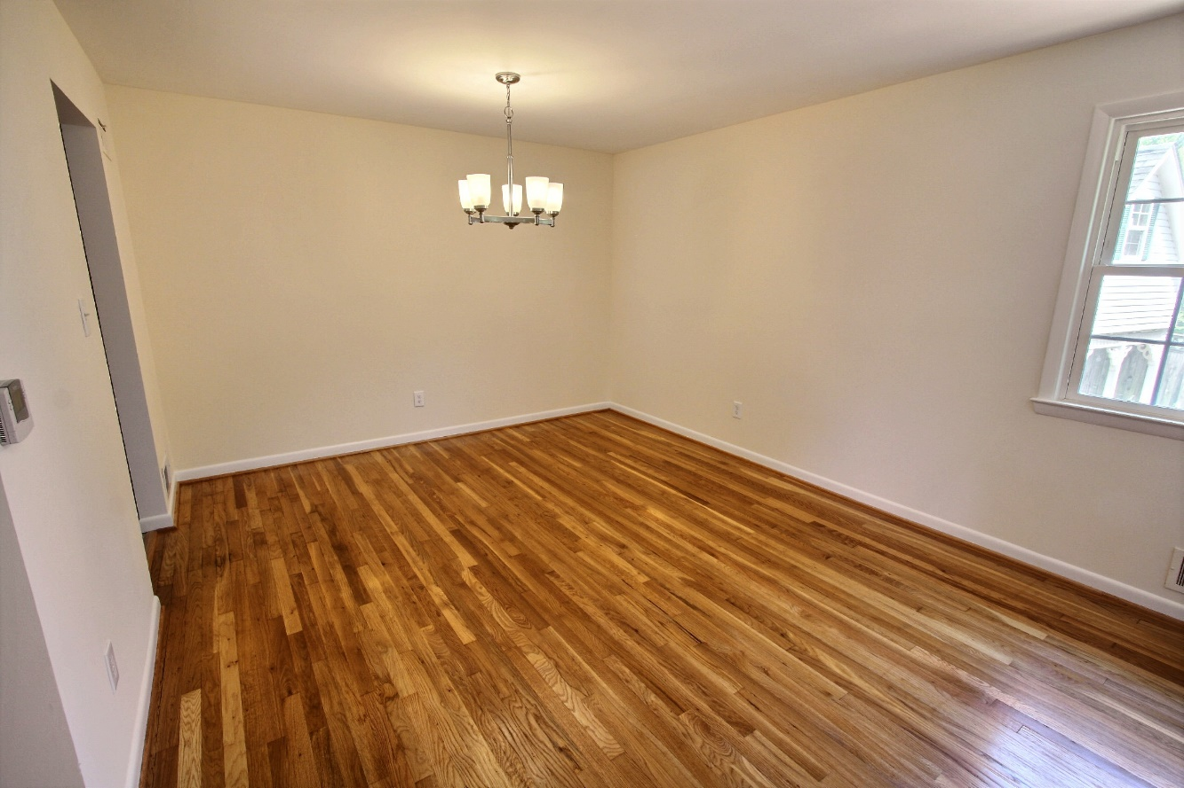
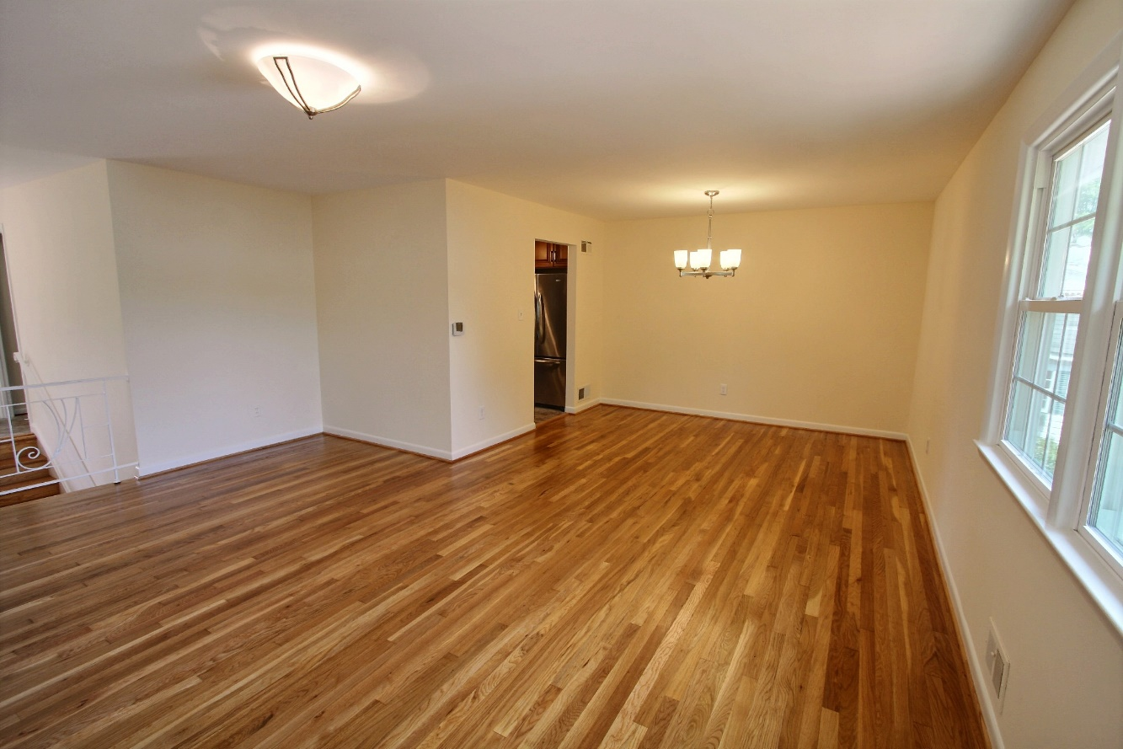
The dining room offers newly refinished hardwood, updated lighting, fresh paint, and also connects to the living room and kitchen. All windows are triple-paned.

Slide 6
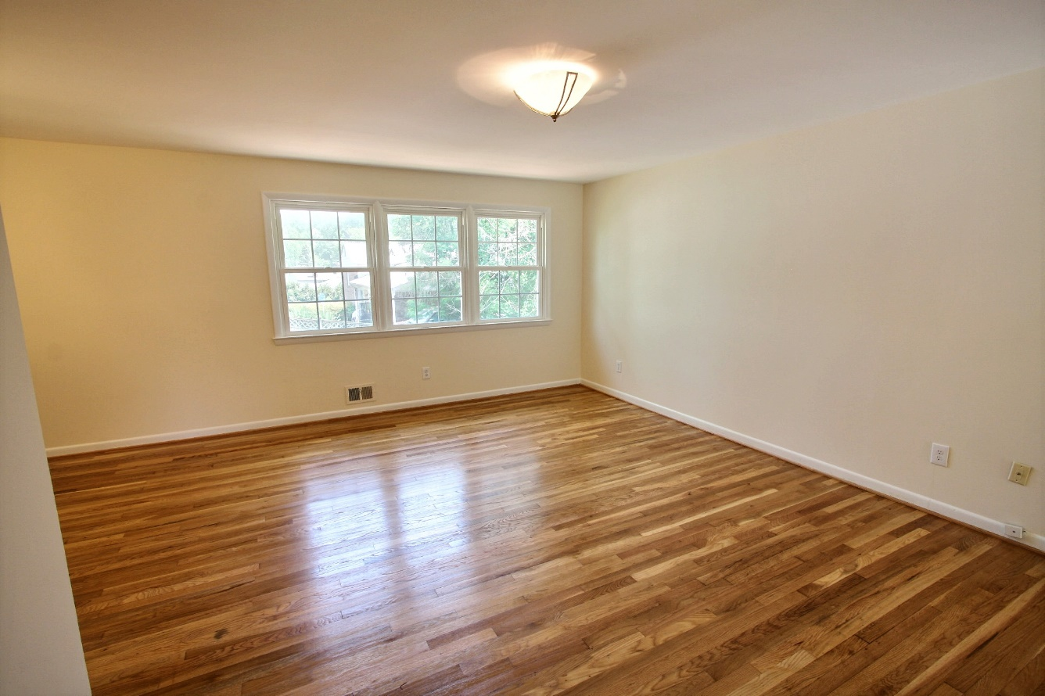
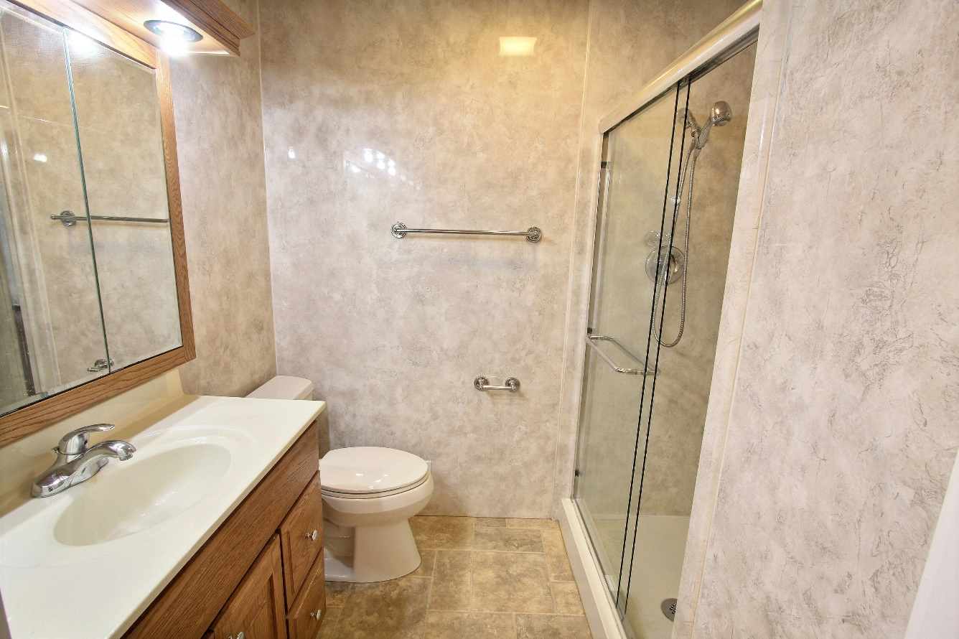
The living room offers updated windows, new lighting, hardwood floors, and fresh paint. Just down the hall are the hall bathroom and main level bedrooms. The bathroom features an updated shower.

Slide 7
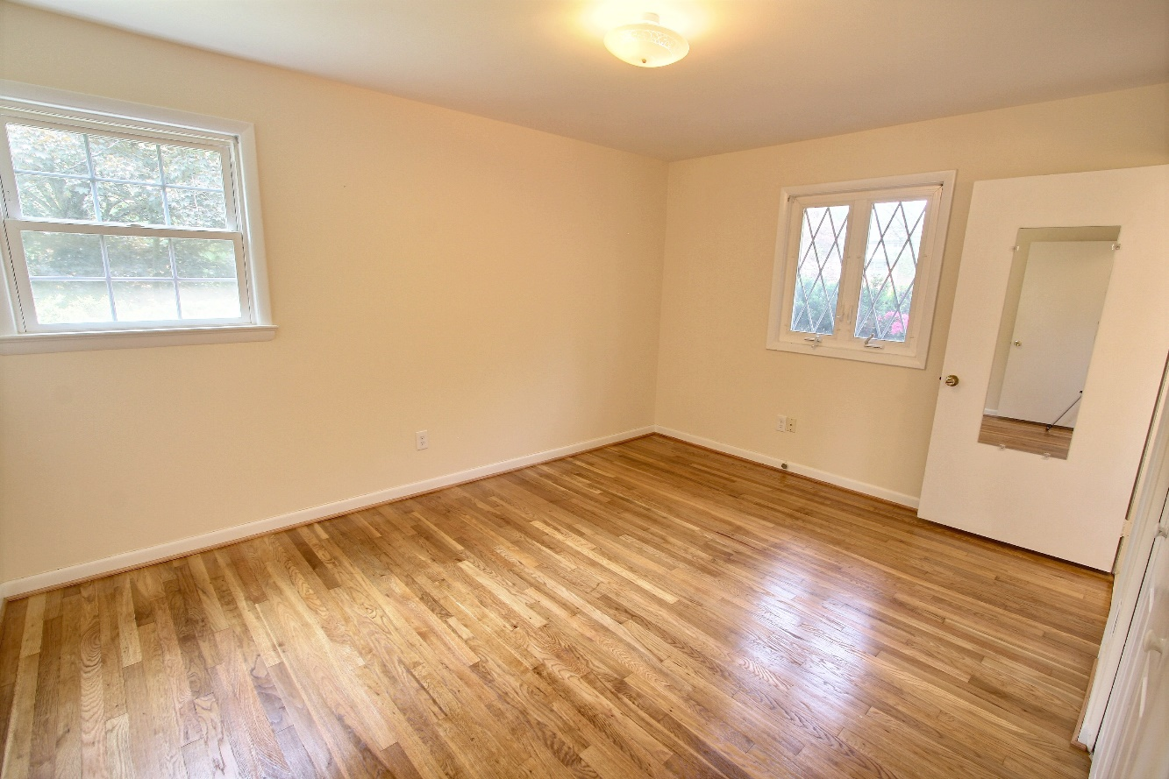
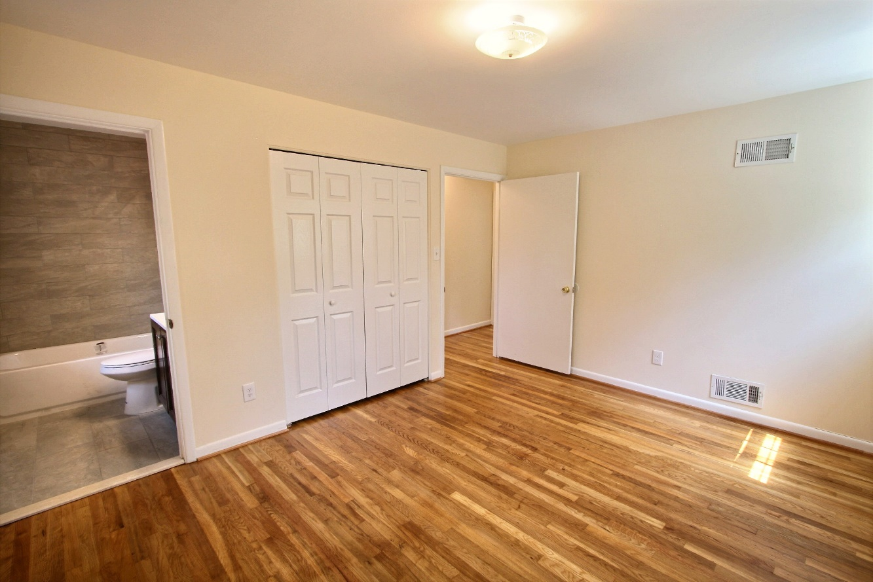
The owners suite includes hardwood floors, fresh paint, great views of the yard, and a newly renovated private bathroom.

Slide 8
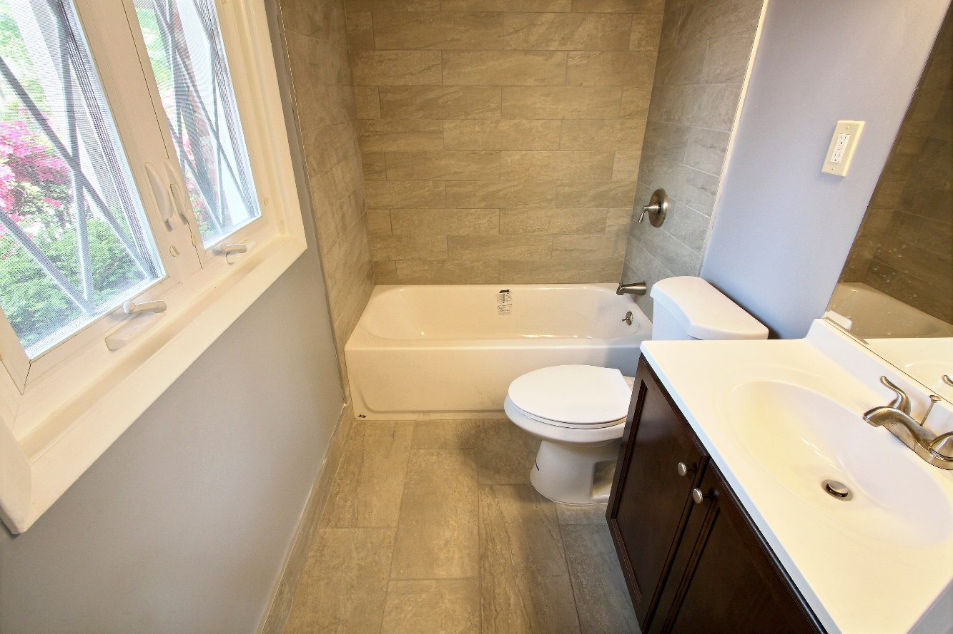
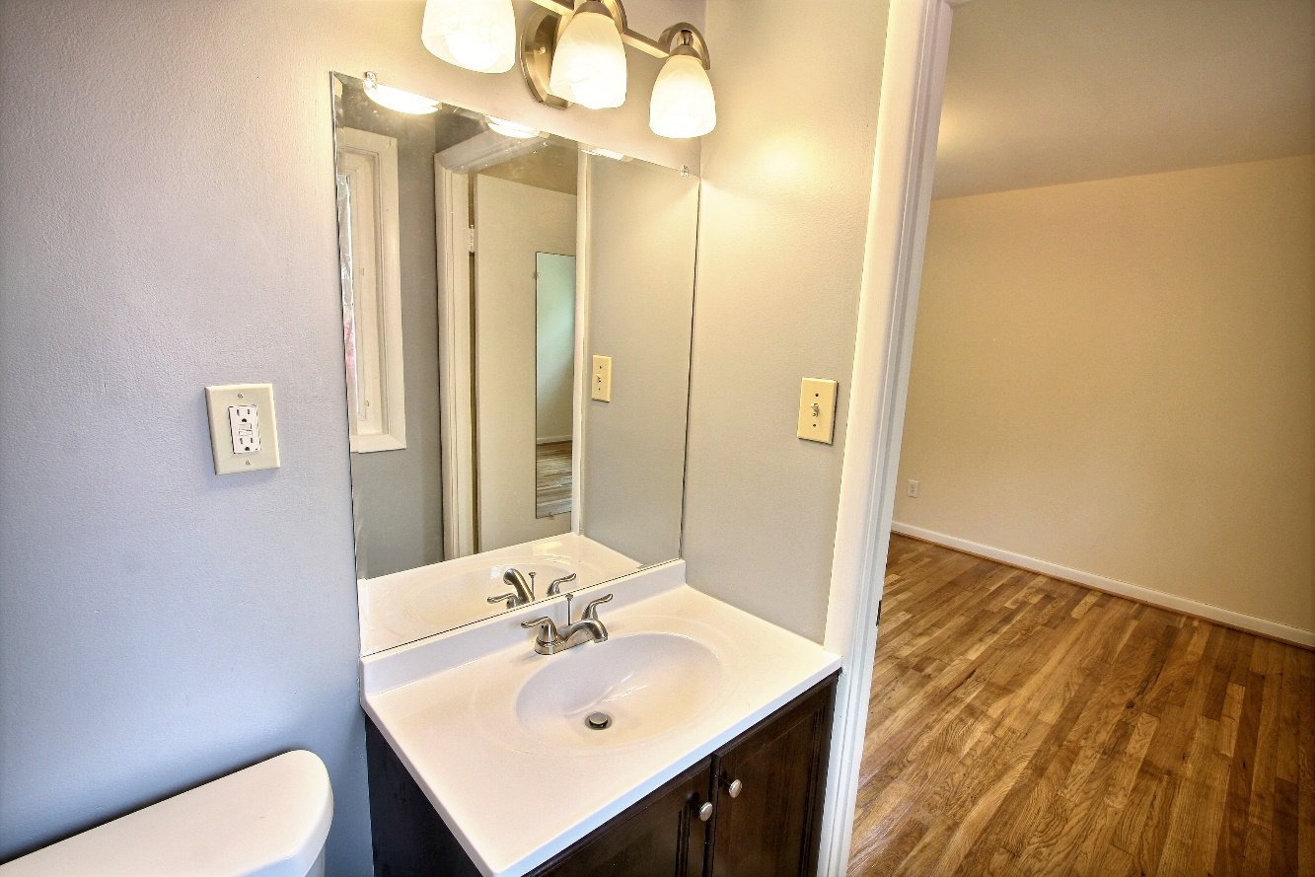
The owners bathroom has been completely redone with new tile on the floor and shower surround. A new toilet and tub, a new cabinet, new lighting, and a new mirror to finish off the space.

Slide 9
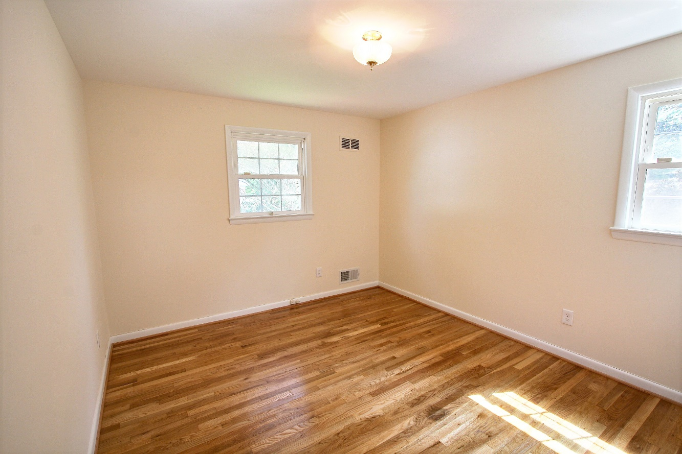
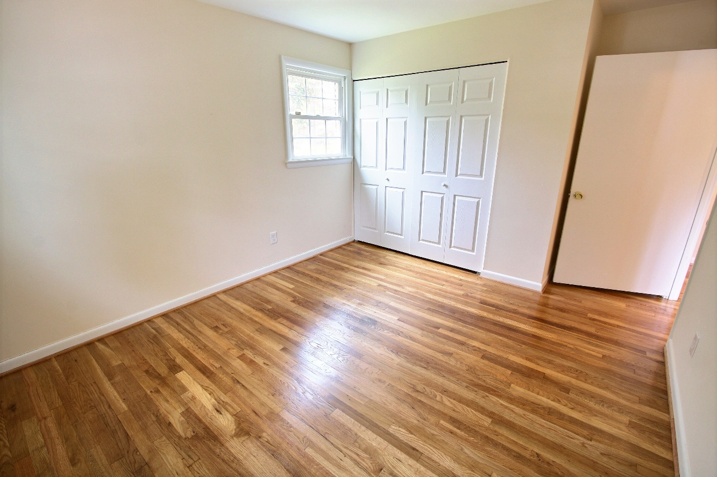
The spacious 2nd bedroom offers hardwood floors,
fresh paint, and a large closet.

Slide 10
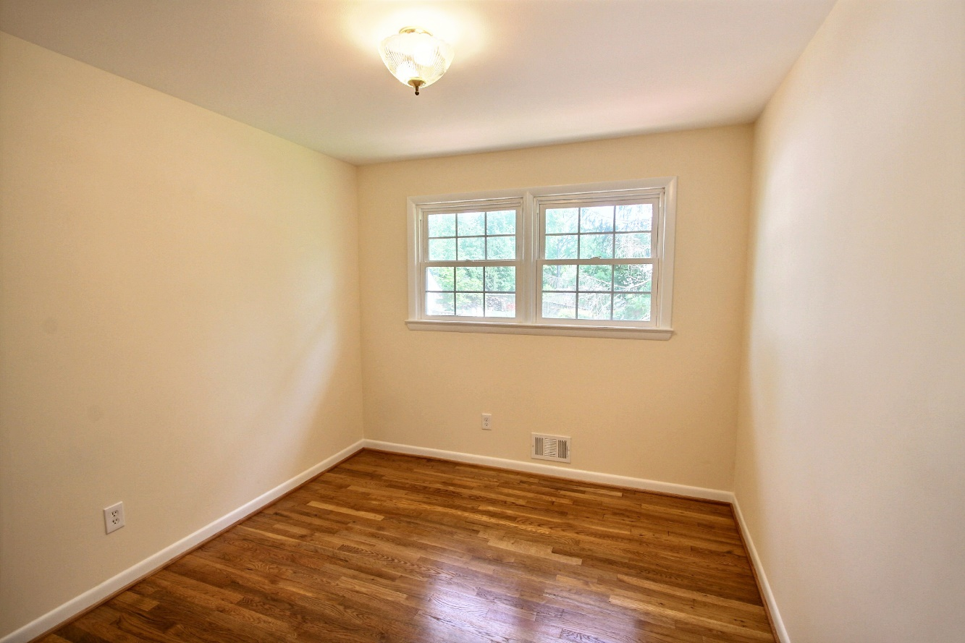
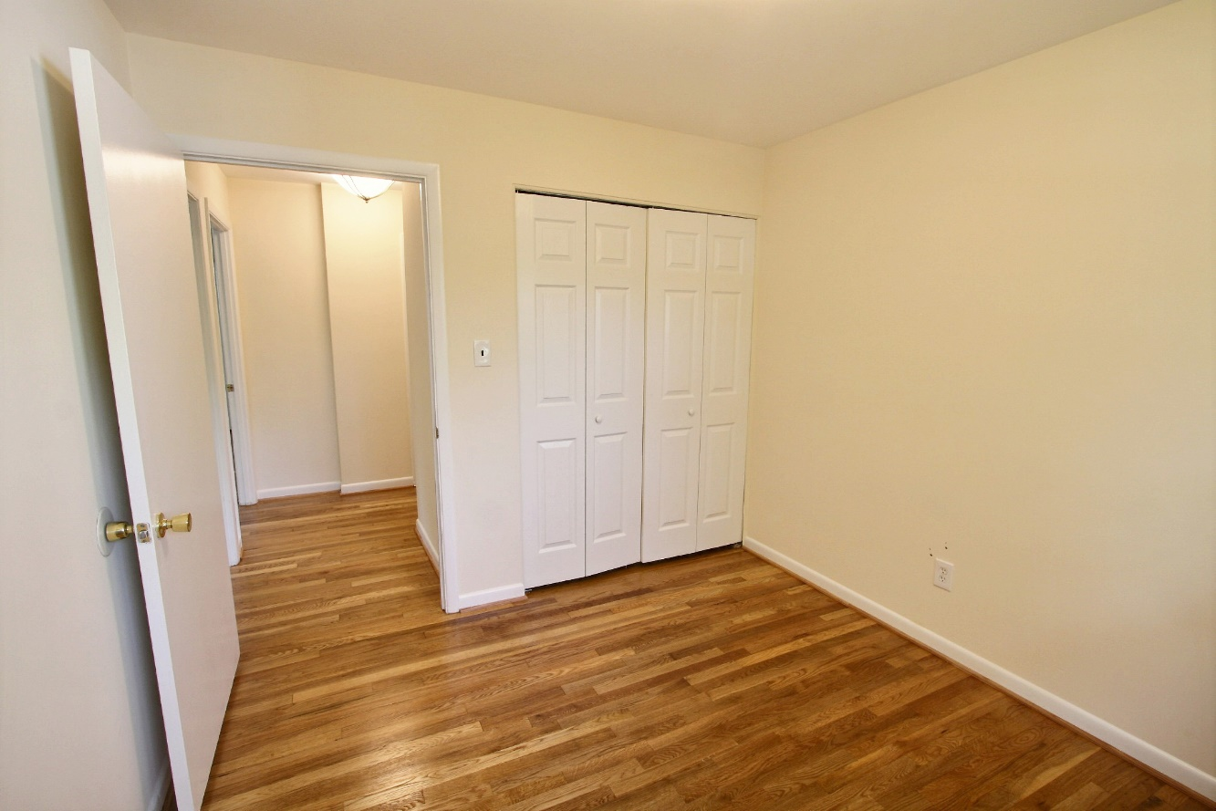
The 3rd bedroom offers hardwood floors, fresh paint, a double-door closet and great views of the backyard.

Slide 11
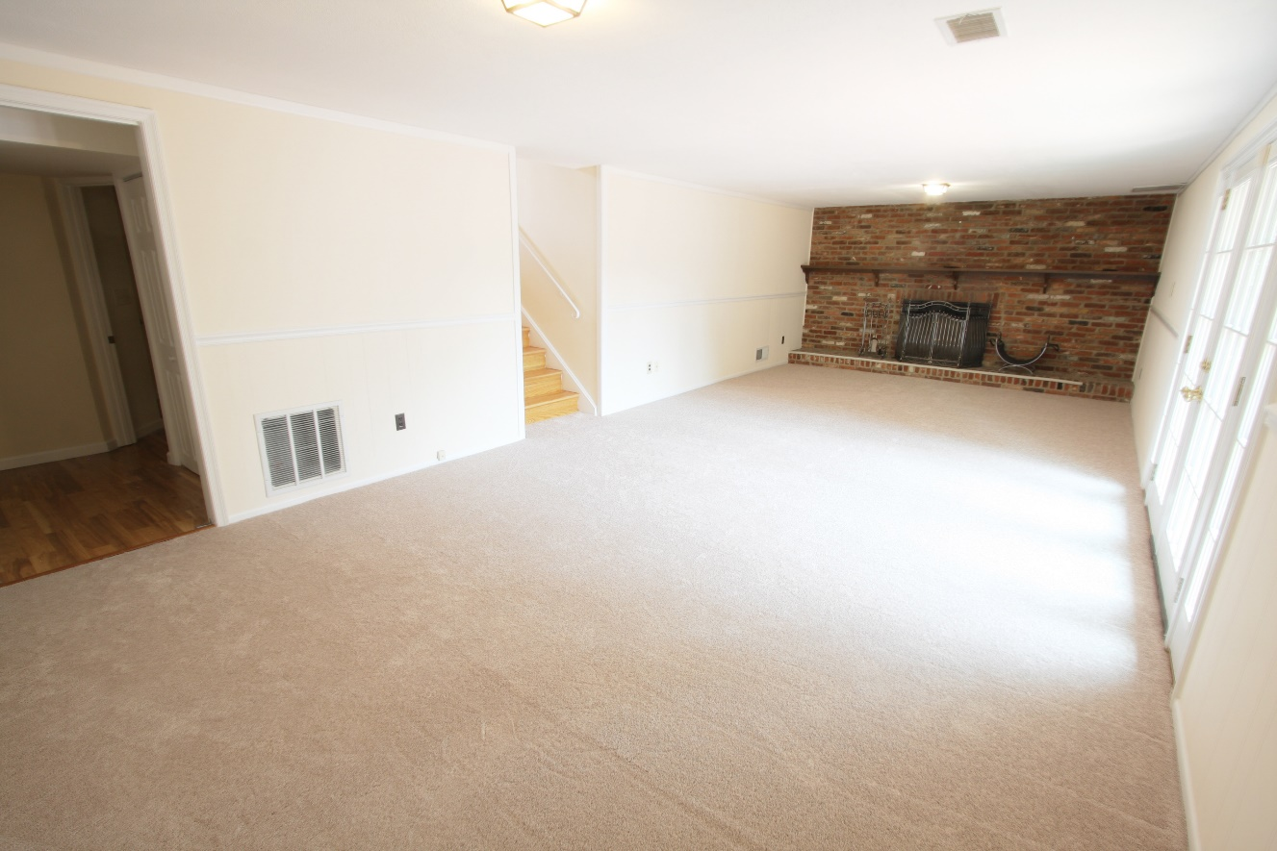
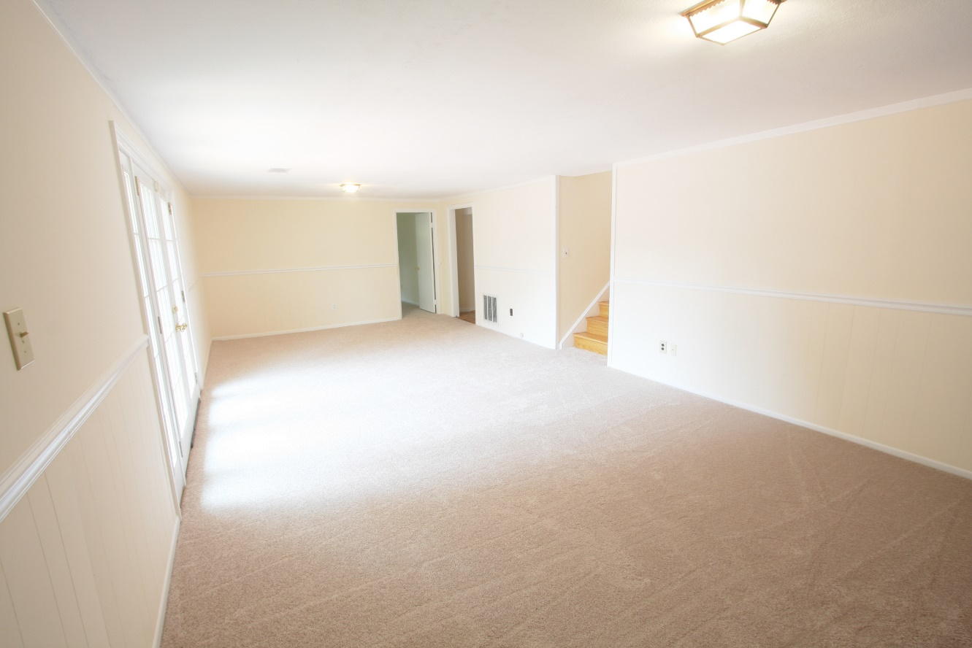
The lower-level features a large family room with a gas fireplace, new carpet, fresh paint, and access to the outside porch, laundry room, the additional bedroom, bathroom, and entertainment room.

Slide 12
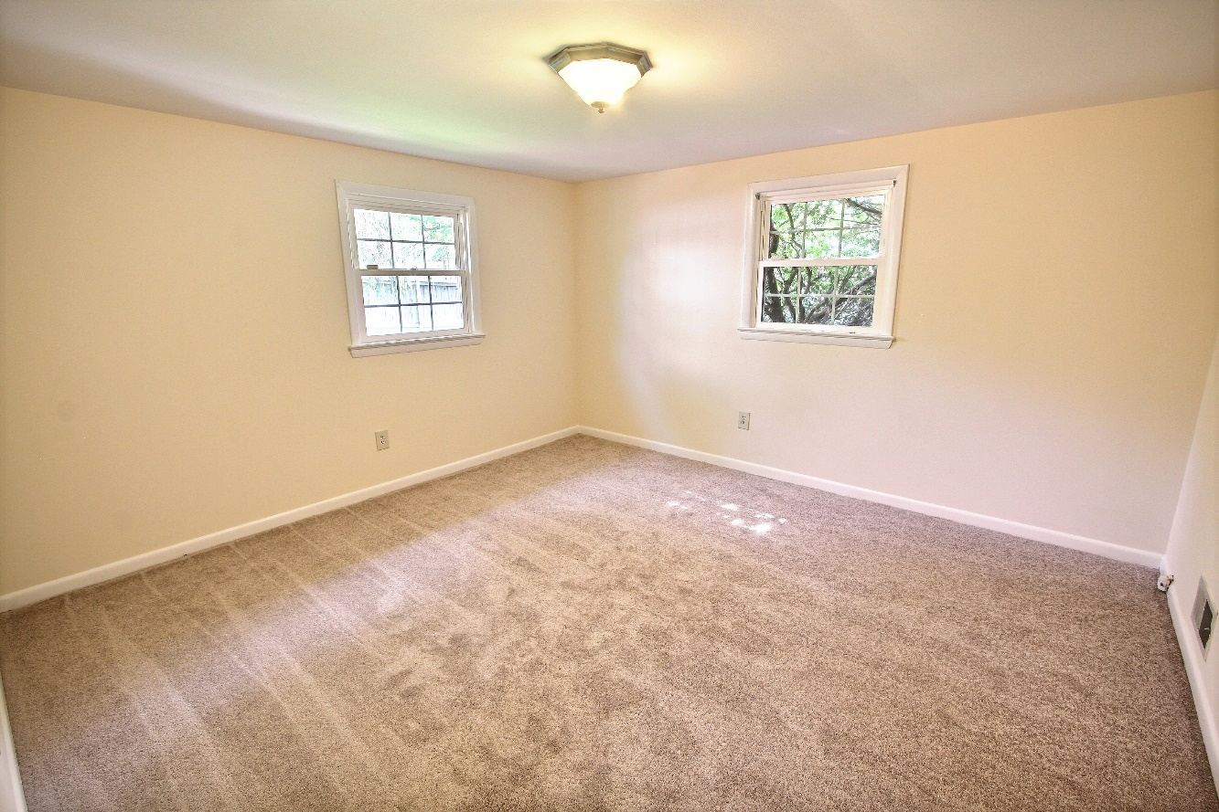
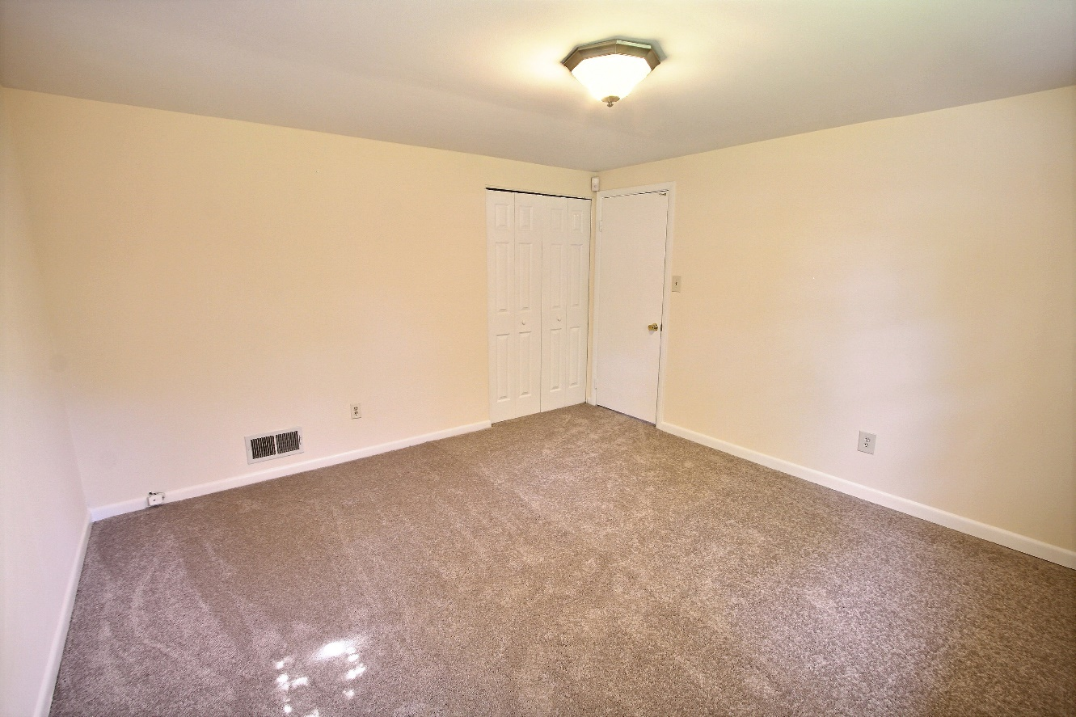
The spacious lower-level private 4th bedroom features
fresh carpeting and fresh paint. It’s located just off the
lower-level family room.

Slide 13
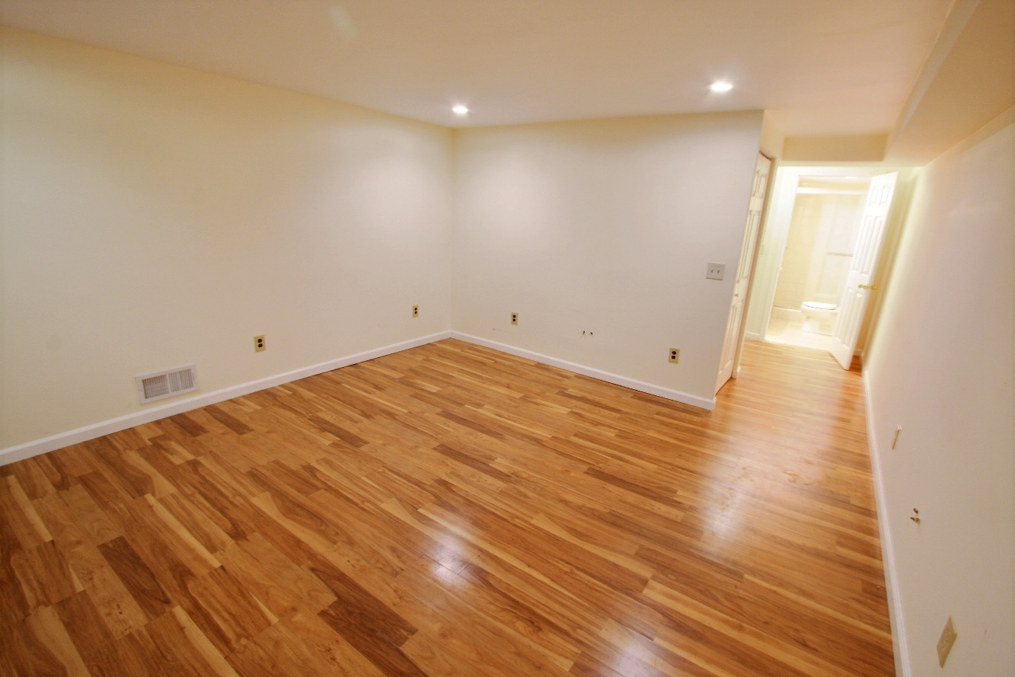
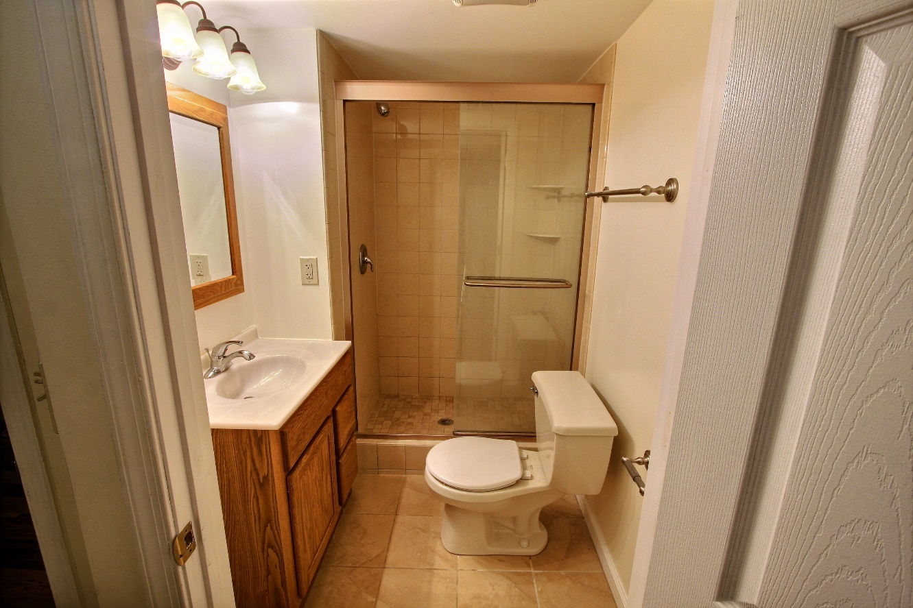
The entertainment room features laminate floors, a storage closet, and a full bath. The full bath offers tile floor, updated lighting, an updated shower, and ample power outlets for all your technology.

Slide 14
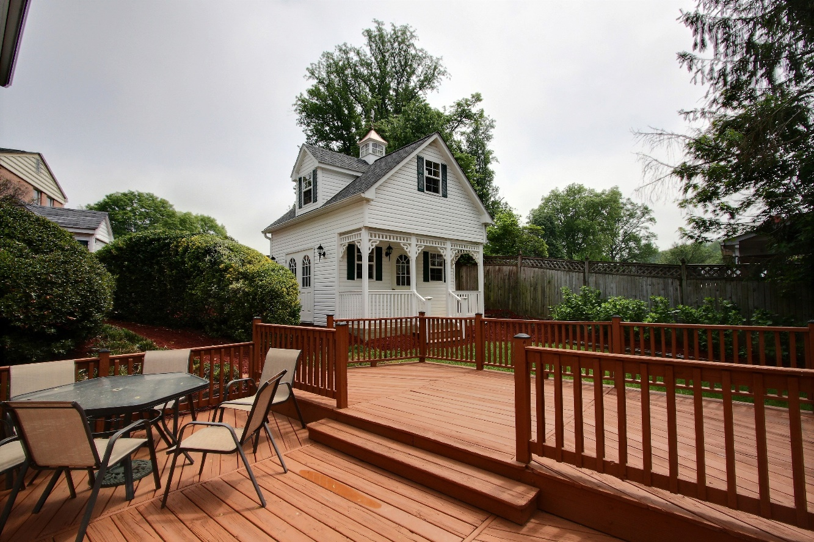
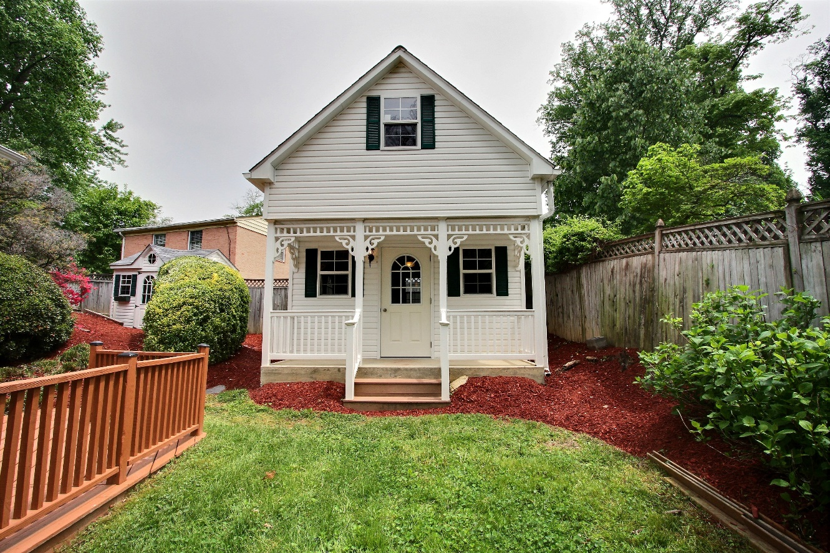
Outside, enjoy a large 2-story, 380 sqft Amish shed, electricity and cable ready. It offers additional storage, a hangout space for friends/kids, and/or a cozy spot for when the in-laws visit.

Slide 15
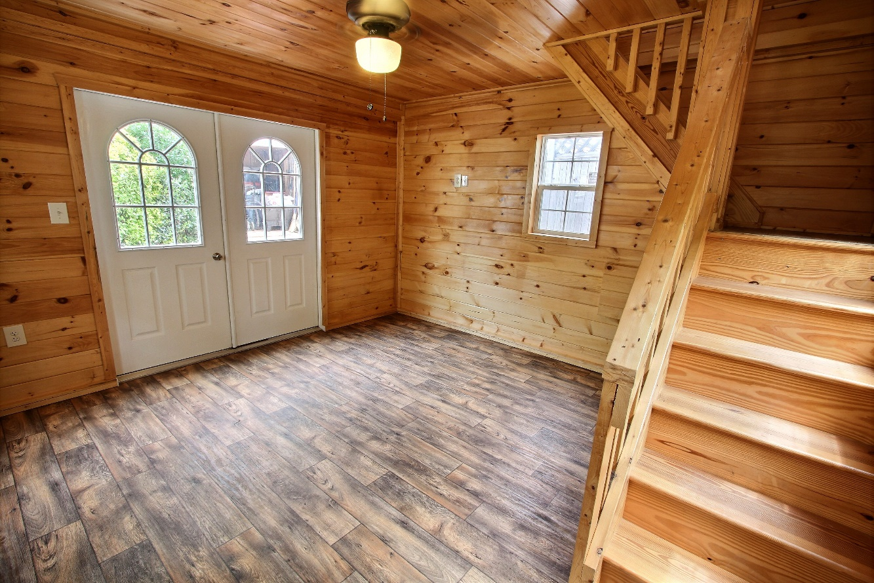
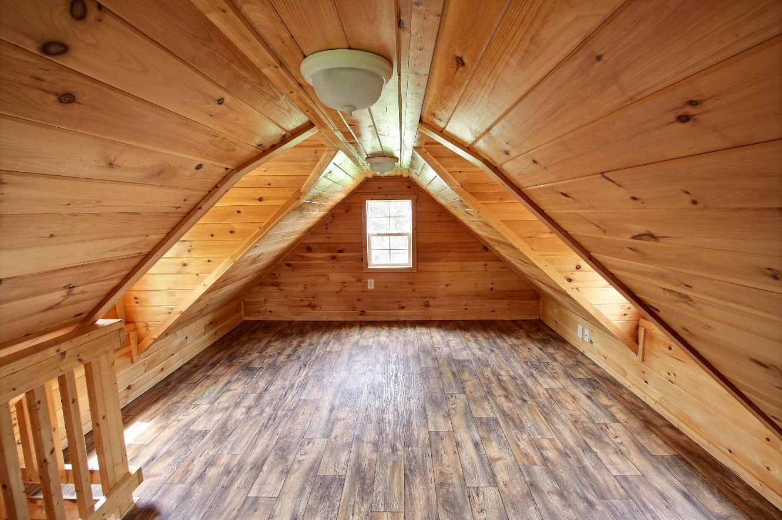
The Amish shed features a 100% pine interior, highest grade vinyl flooring, a downstairs living space, and also an upstairs sleeping quarters or a hang-out spot.

Slide 16
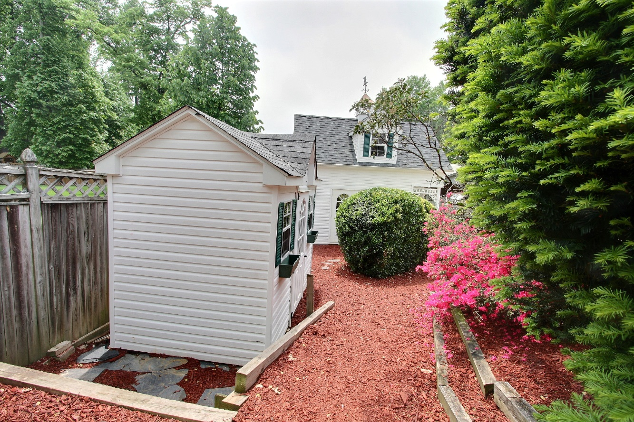
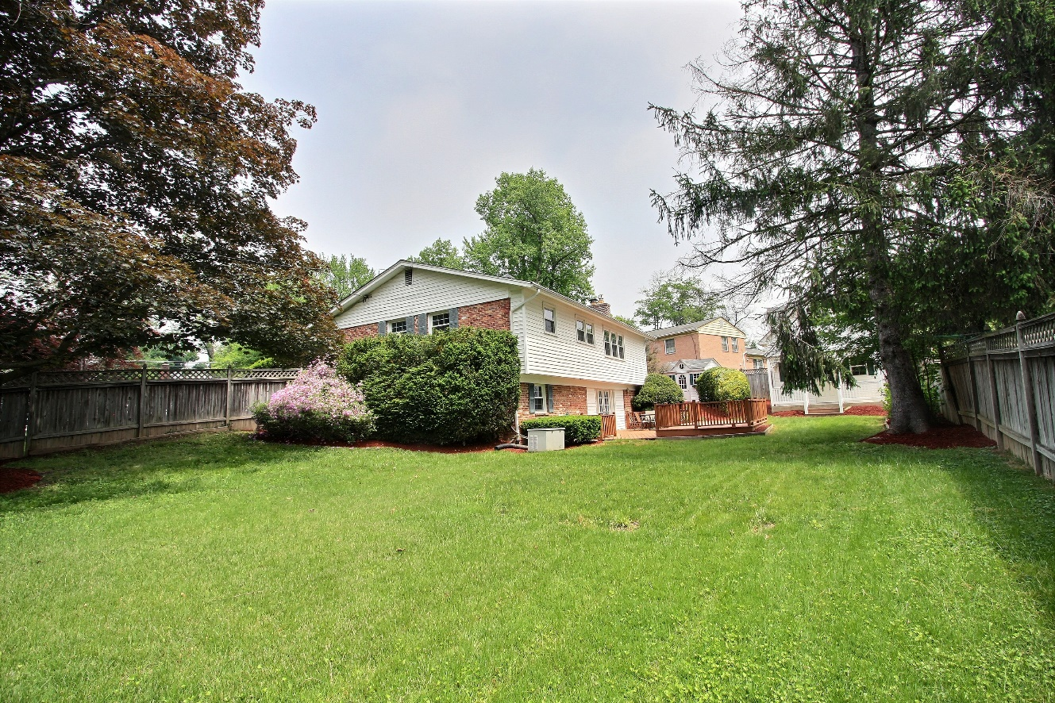
There are multiple storage sheds in the spacious yard, as well as a automatic 16,000 watt house generator, strong enough to power the whole house and Amish shed within 30 seconds of a power outage.

Slide 17
List of Recent Home Improvements
ITEM | YEAR COMPLETED | COST
Triple Pane Krypton Glass Windows & Custom Designed French Doors | 2004 | $27,500
Roofing | 2010 | $8,500
Steel Doors – Highest Grade & Thickness allowed | 2004 | $3,700
Driveway – Expanded New Carport, New Walkway, New Carport – Expansion Ready (10 ft Deep) | 2010 | $18,500
Durastone – Paving for Drive | 2010 | $13,000
Hallway Bathroom | 2008 | $14,000
Amish Tool Shed | 2011 | $3,100
Generac Generator | 2008 | $8,000
Basement Renovations | 2013 | $14,000
2 Story Amish Shed | 2012 | $25,500
AC & Furnace | 2012 | $7,500
Gas Fireplace – Basement | 2008 | $2,200
Kitchen Renovation | 2013 | $16,500
Attic R48 – Foam Insulation | 2010 | $1,200
Bathroom, Fence, Renovated Deck, New appliances, Boilers, and ADT Security system w/sensor | 2018 | $21,800
TOTAL: | $185,000

Slide 18
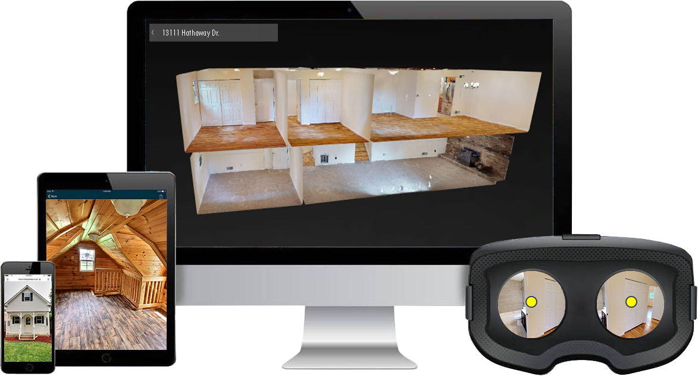
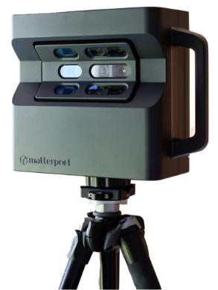
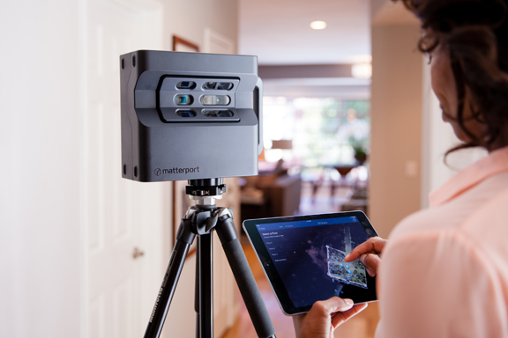
3D Virtual Tour Online: 13111M.AlexSaenger.com
13111 Hathaway Dr, Silver Spring, MD 20906
Saenger Group uses Matterport technology to bring our listings directly to you with a 3D Virtual Tour. Step inside, look around, and if you have VR capability, view the home from your headset.
Also available is the dollhouse view where you
can see an overhead scan of the entire home.
301-251-1221 x1000
Homes@AlexSaenger.com

Slide 19
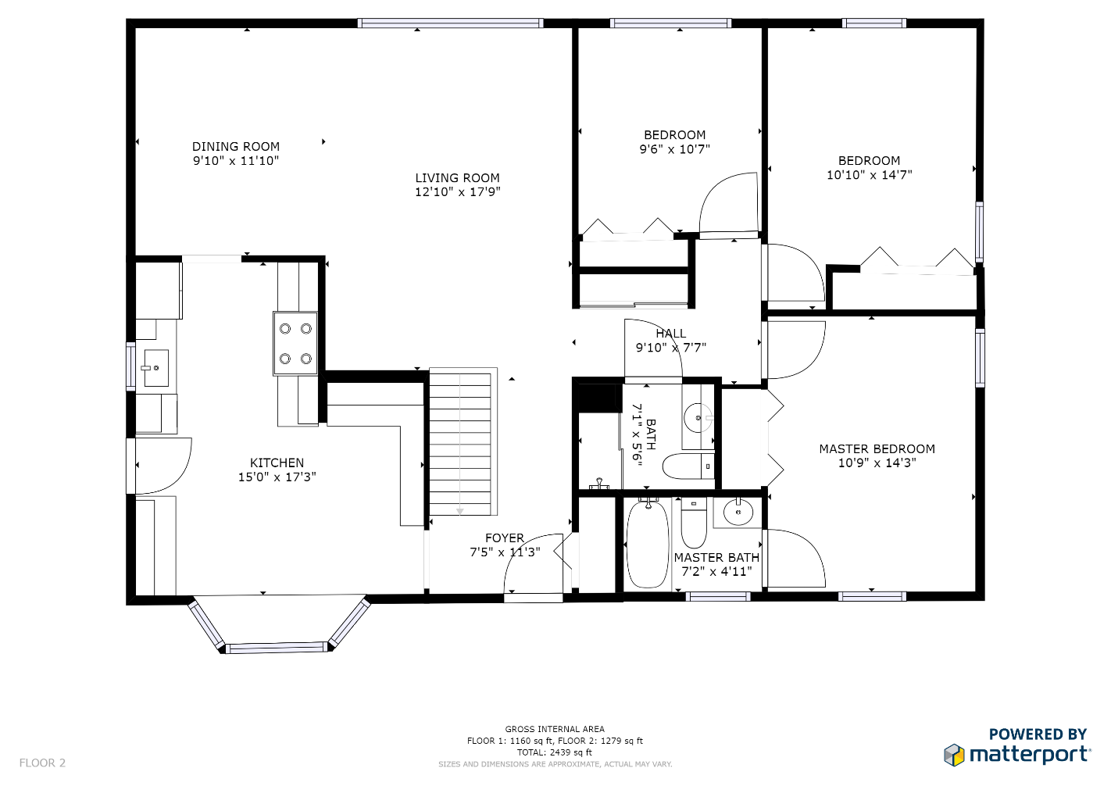
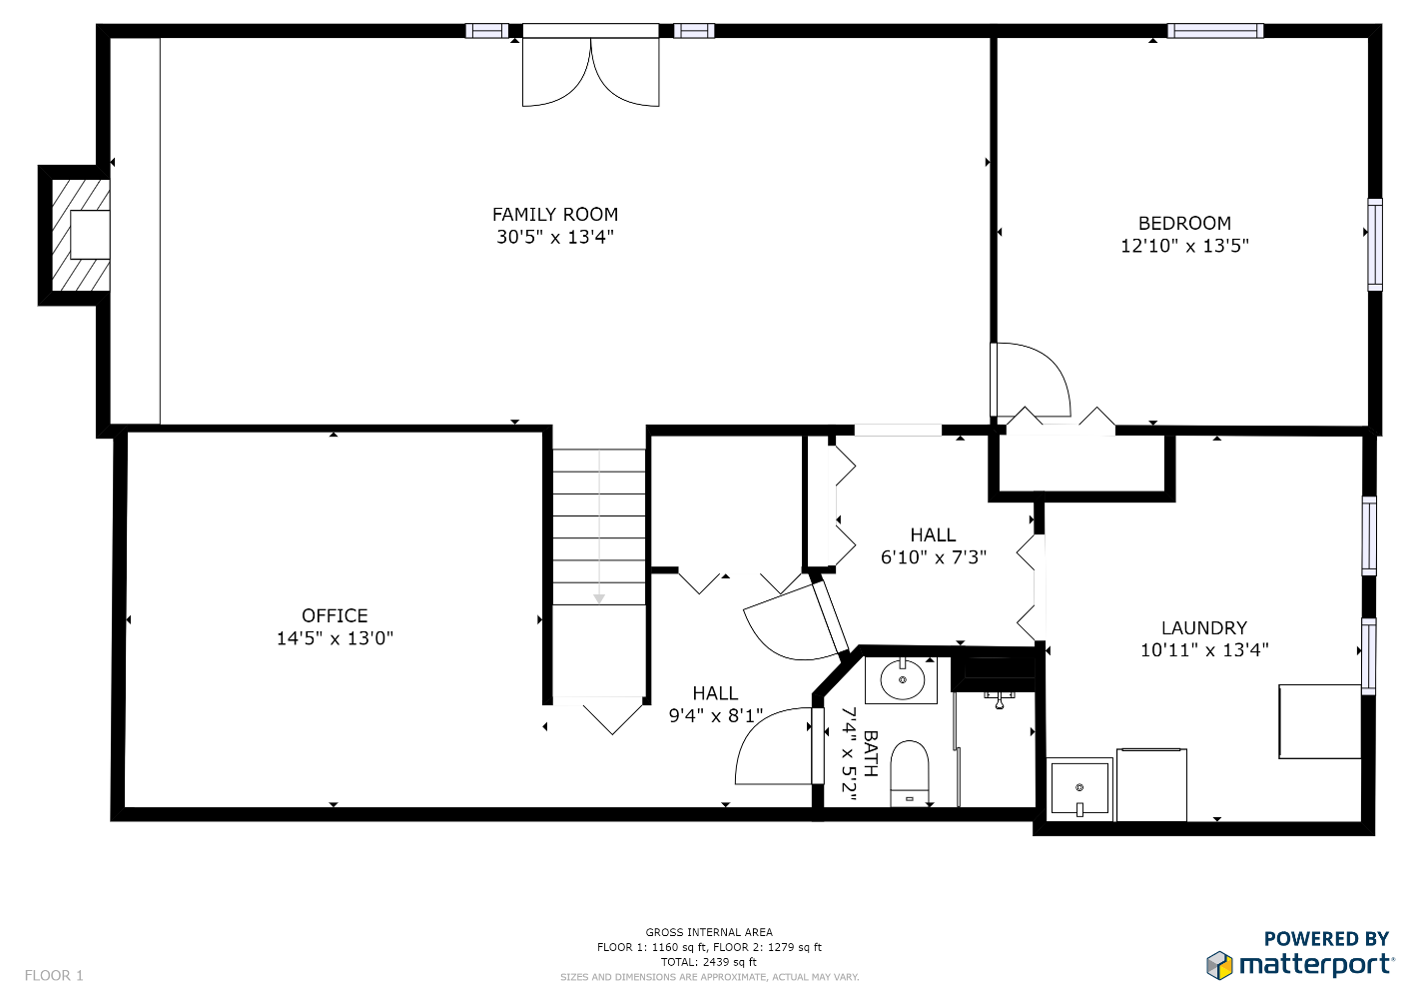
301-251-1221 x1000
Homes@AlexSaenger.com

Slide 20
Your Home’s Lifestyle Worksheets – Page 1
Top 5 Community Amenities (Parks, Pools, Sidewalks, Playgrounds, Tennis, Basketball, etc.)
1) Wheaton Regional Park
2) Wheaton High School Swimming Pool
3) Wheaton Shopping Mall
4) Aspen Hill Country Club
5) Sligo Creek Park
Other – Downtown Washington D.C. ~ 10 Miles
Holy Cross Hospital ~ 5 Miles
Montgomery General Hospital ~ 7 Miles
Top Commuting/Transportation Assets
Closest Bus Stop Intersection – Georgia Avenue & Hathaway Drive ~ 300 yards
Closest Train Stops (Metro/MARC)
Glenmont Metro – Last Stop on Red Line ~ ¼ Mile
Closest Airports (Ranked by Distance)
BWI – Baltimore – 31.3 Miles
Dulles International – 31.2 Miles
Montgomery County Air Park – 9.5 Miles
_____________________________________________________________________________
Closest Major Highway Intersection (i.e. 270/Route 28 exit 8)
ICC 200 - Tall Rd ~ 2 Miles
I95 ~ 12 Miles
I270 ~ 14 Miles

Slide 21
Your Home’s Lifestyle Worksheets – Page 2
Top 5 Lifestyle Benefits of Your Home (Close to a Gym/Shopping, Yard is Great for Kids and Pets, etc.)
1) Amish Shed 20’ x 20’. 2 Floors. Electric and Cable Ready
2) Privacy Fence 7’
3) Backup Generator – No loss of electricity/Power
4) Retro Fitness – Large 2 Tier Outside Deck
5) Extremely Floral and very green for the nature lover
Other – 2 Additional Sheds – Tool & Bicycle
Top 5 Favorite Nearby Restaurants (i.e. Coastal Flats – Downtown Crown)
1) The Silver Fountain
2) The Big Greek Cafe
3) Panera Bread
4) Chipotle
5) Sole D’Italia Restaurant
Other – Outback Steakhouse, Villa Maya Restaurant, Over 100 Additional places to dine, just in Wheaton/Aspen Hill Area.
Closest Coffee Shops (i.e. Starbucks – Falls Grove)
1) Starbucks - Norbeck
2) Dunkin Donuts – Aspen Hill
3) Rick Roasters at Rock Creek - Kensington
Other – Allegro Coffee - Rockville

Slide 22
Your Home’s Lifestyle Worksheets – Page 3
Closest Grocery Stores (i.e. Giant - Kentlands)
1) Giant Food – Aspen Hill Shopping Center
2) Lotte Plaza Market – Aspen Hill
3) Shoppers Food – Aspen Hill
4) Safeway – Norbeck
5) Aldi - Glenmont
Favorite Nearby Shops (Dept. Store, Home Improvement, Gifts, Home Furnishings, Pet Store, Etc.)
1) Home Depot – Aspen Hill
2) Pet Smart – Cherry Hill Shopping Center
3) Marlo Furniture - Rockville
4) Tuesday Morning – Aspen Hill Northgate Plaza
5) Kohl’s – Aspen Hill Northgate Plaza
Other: Aspen Hill Shopping Center, Wheaton Shopping Mall, Northgate Plaza
Hidden Gems! (i.e. Crepes-A-Go-Go– Kentlands)
1) Brookside Gardens ~ ½ mile away
2) National Capital Trolley Museum ~ 2 Miles away
3) Lake Needwood Park ~ 7 Miles away
4) Olney Theater ~10 Miles
5) President Lincoln’s Cottage
Other: Mormon Center, Washington DC Temple Visitor Center

Slide 23
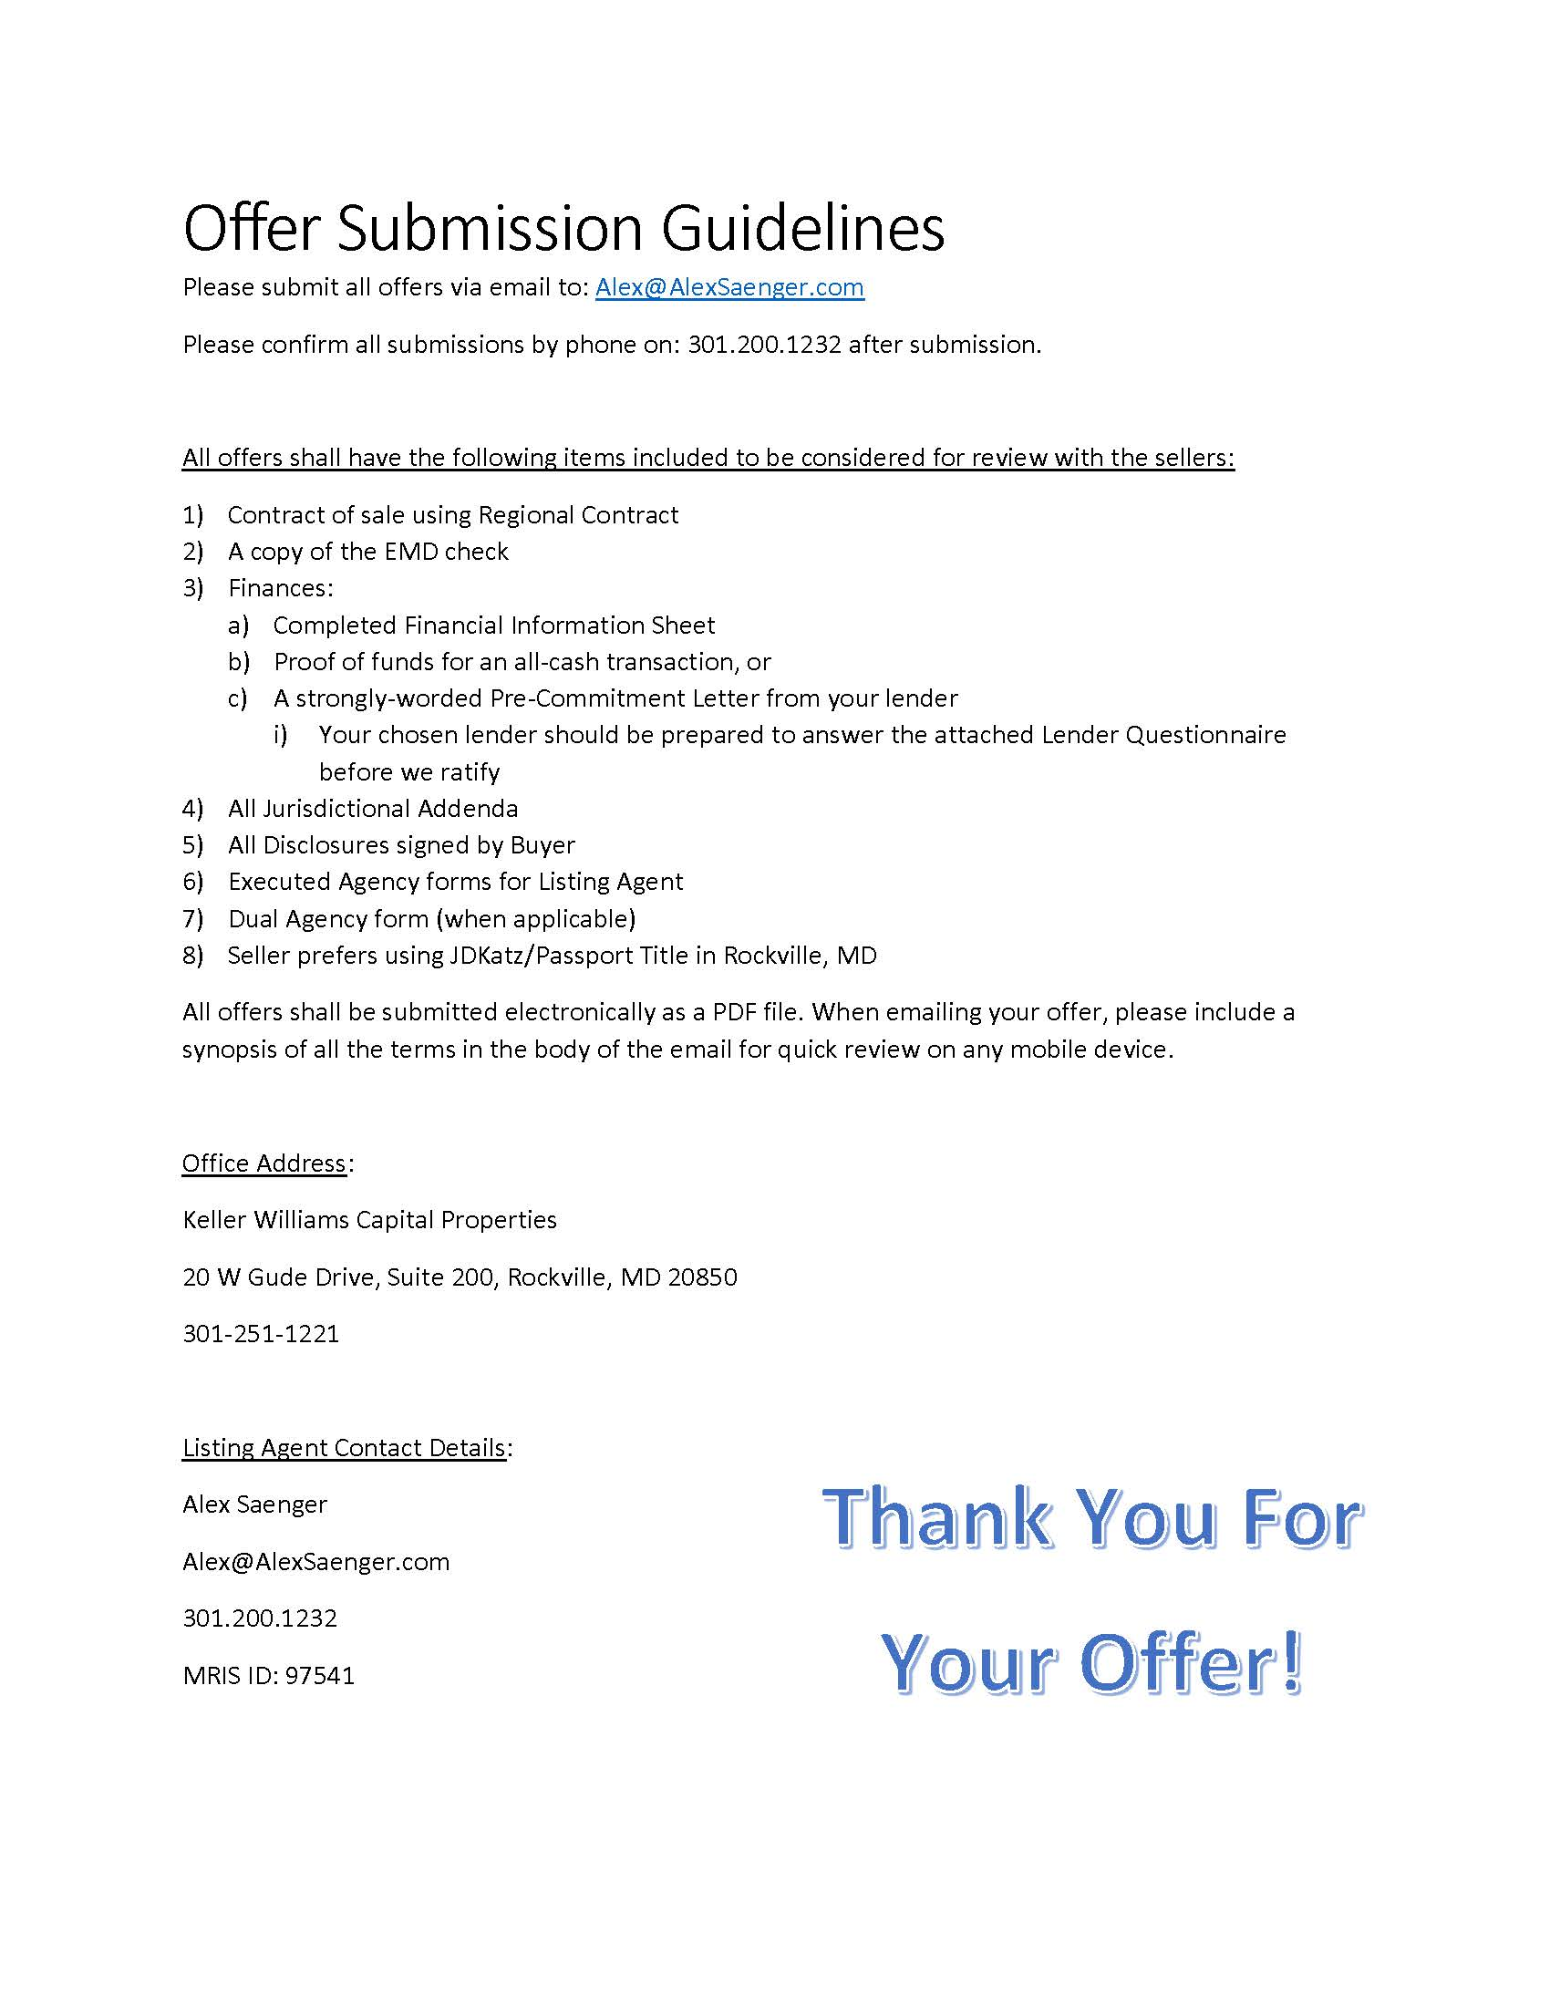

Slide 24
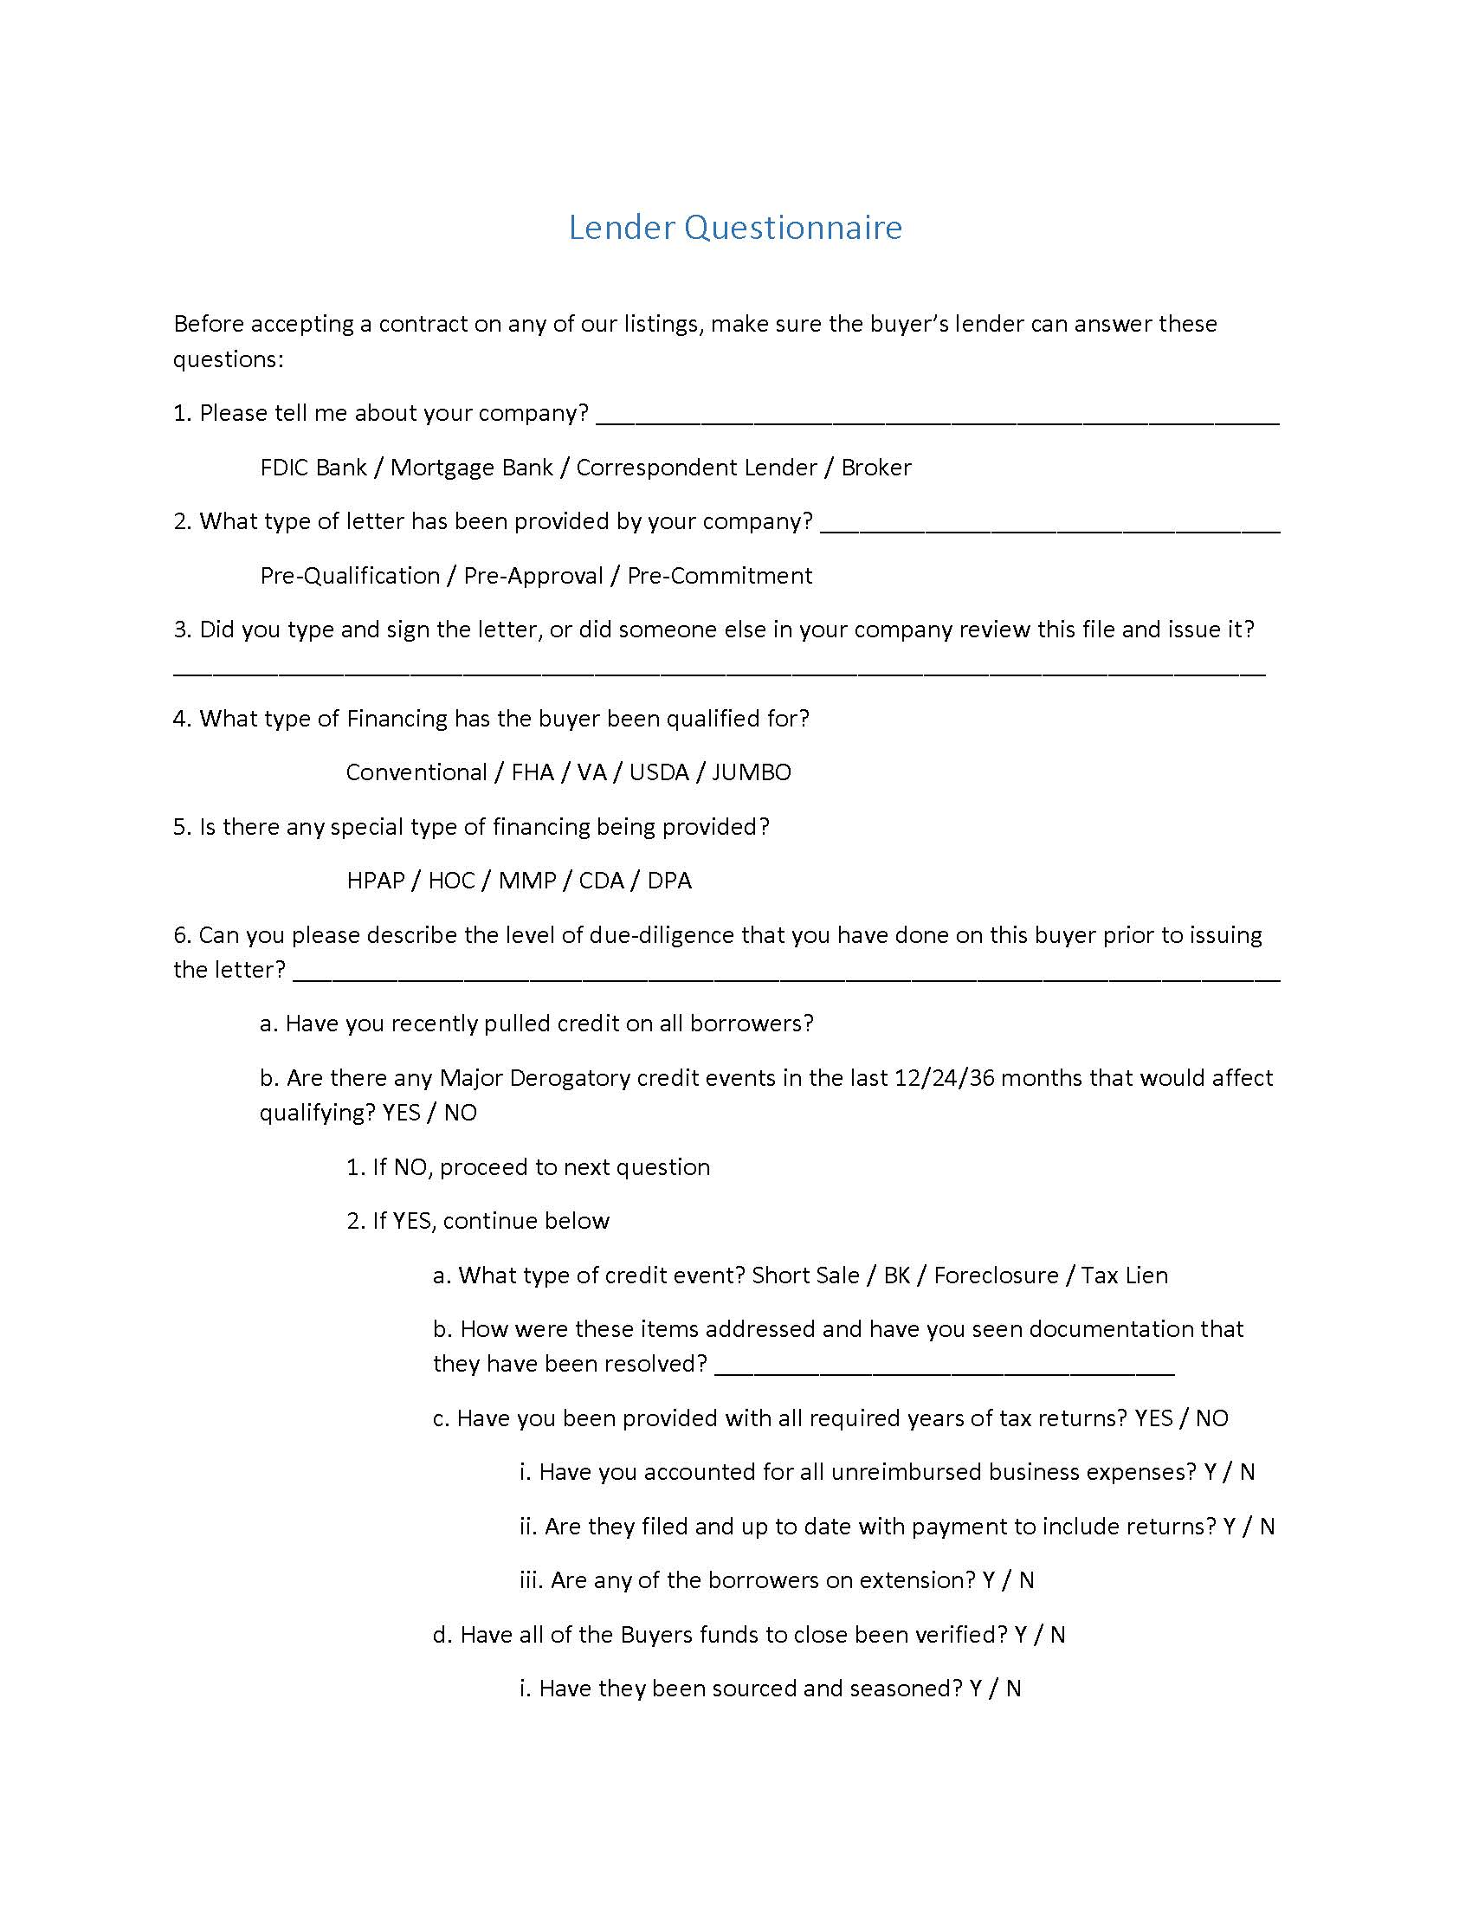

Slide 25
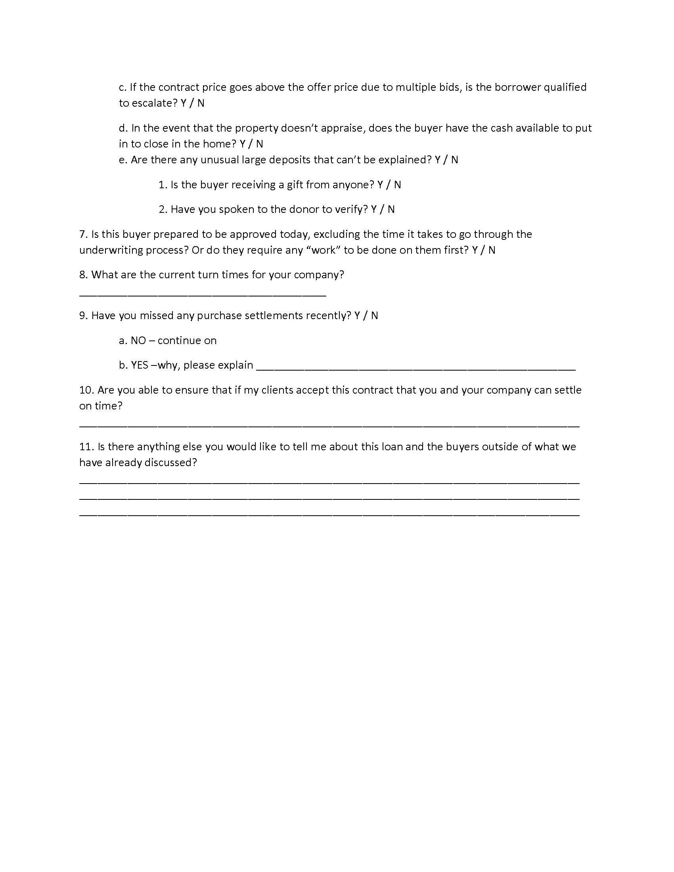

Slide 26
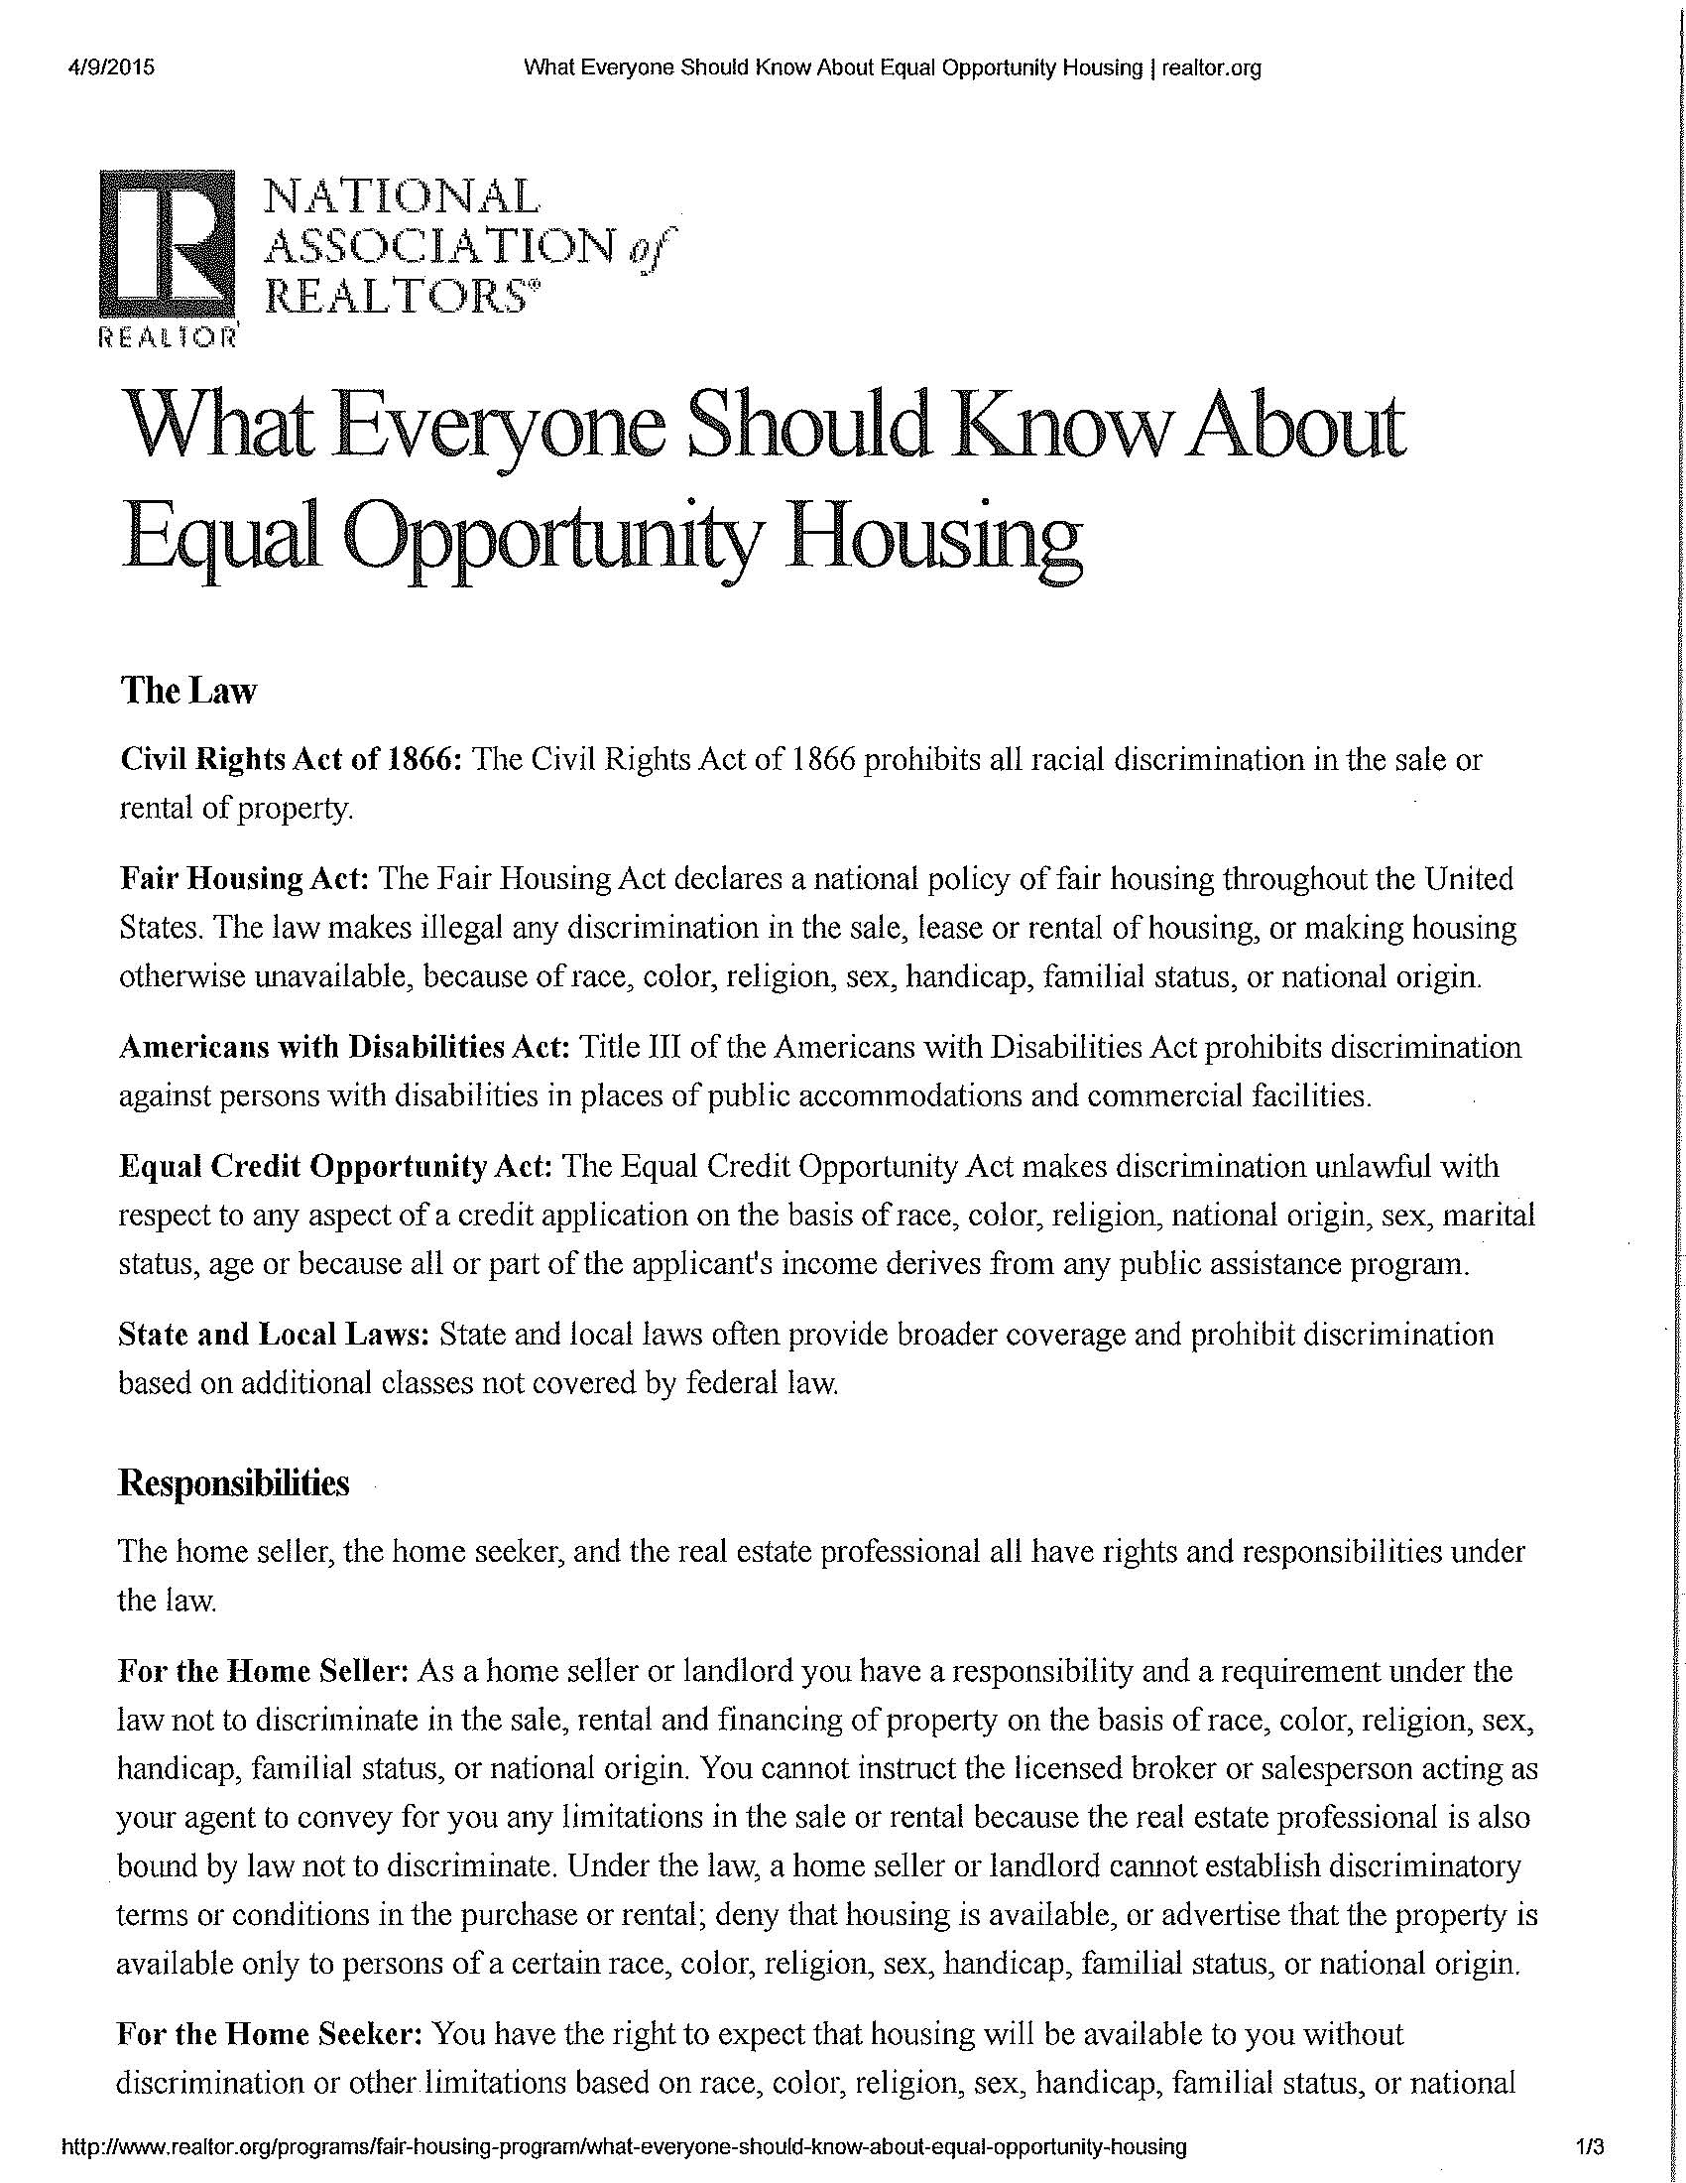

Slide 27
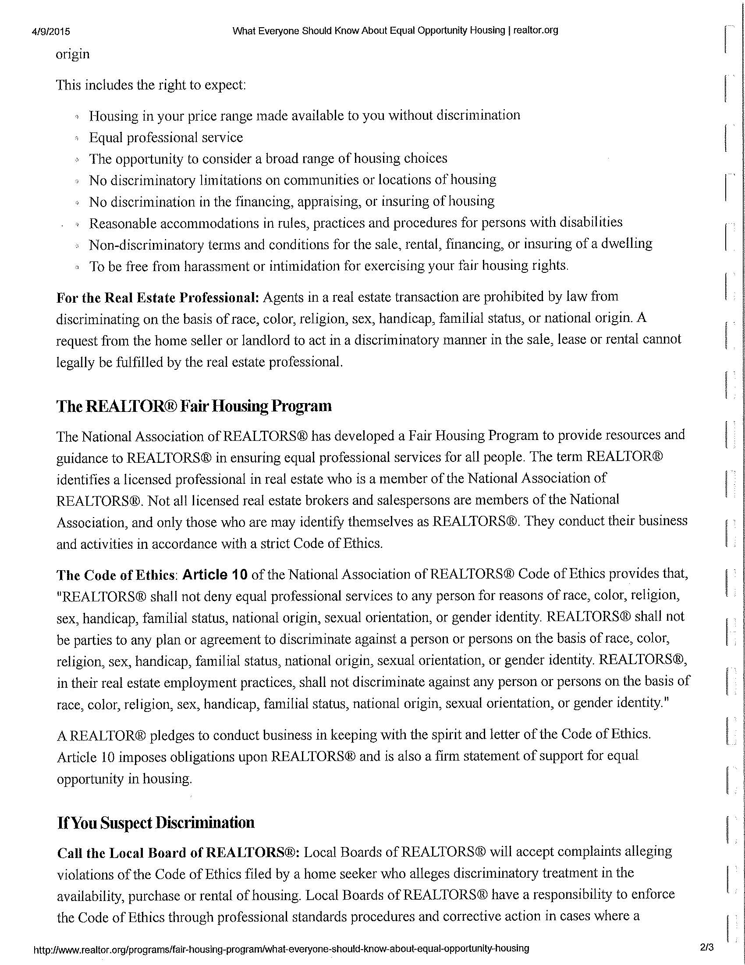

Slide 28
